Slide 1
Mission Partners

Slide 2

Adam and Brandie Crabtree - New York

Slide 3
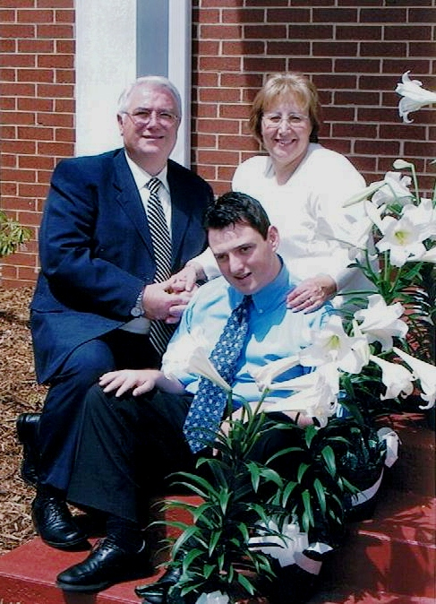
Alejandro and Fina Sanchez – Spain

Slide 4
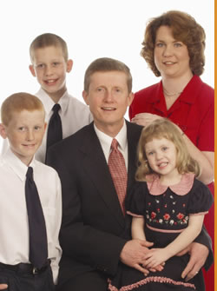
Bill and Tammy Brouwer - Tanzania

Slide 5
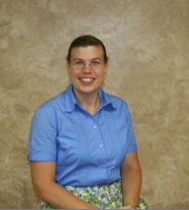
Carrie Mathena - Grenada

Slide 6
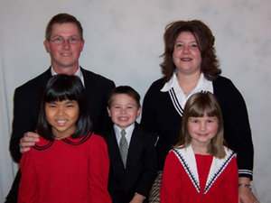
Chris and Stephanie McBryar – Chile

Slide 7
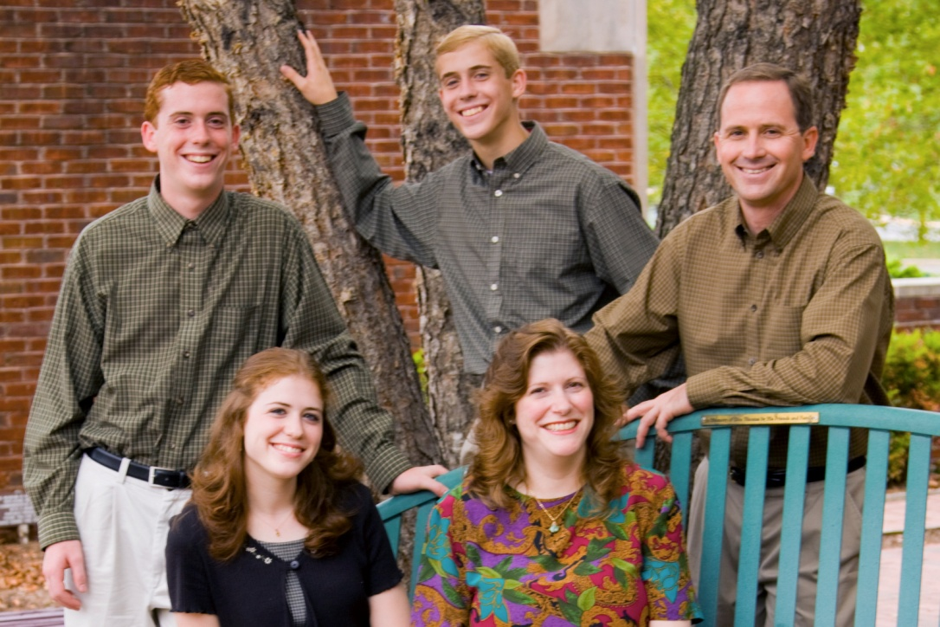
Daniel and Beth Canavan – Ireland

Slide 8
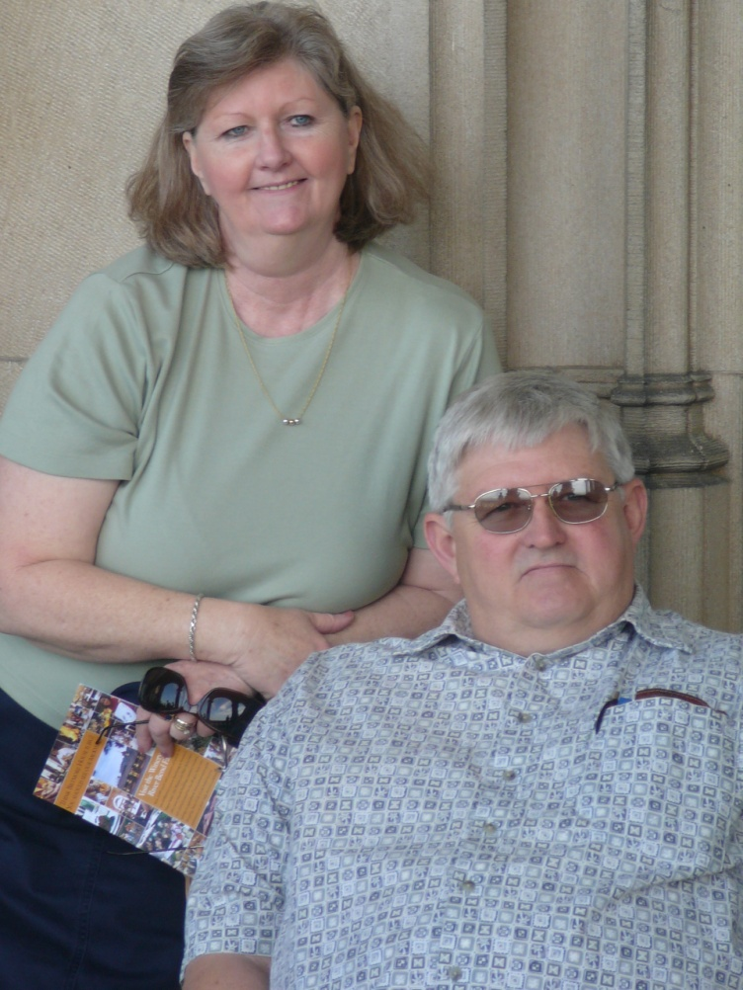
David and Helen Wise - BIBM

Slide 9
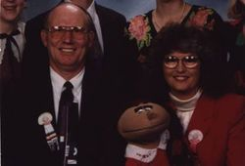
Don and Delores Swearingin - Mexico

Slide 10
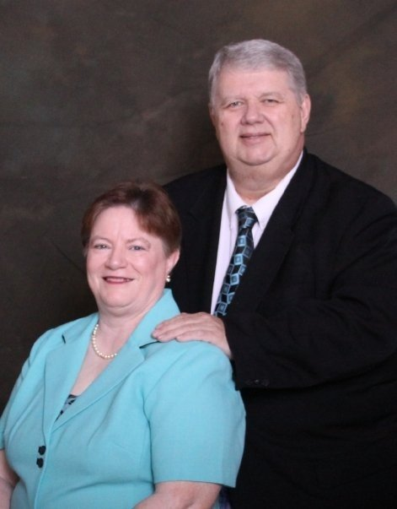
Don and Sharon Bright -
To the Veterans

Slide 11
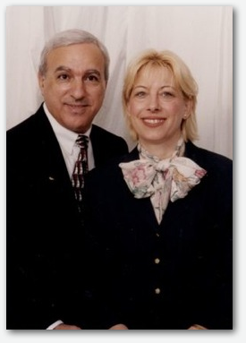
Edgar and Rosann Feghaly - Middle East

Slide 12
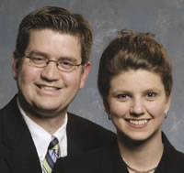
Erik and Holly Johnson - Dominican Republic

Slide 13
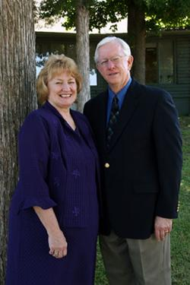
Ken and Carrie Liles - Restricted Access Nations (RAN)

Slide 14
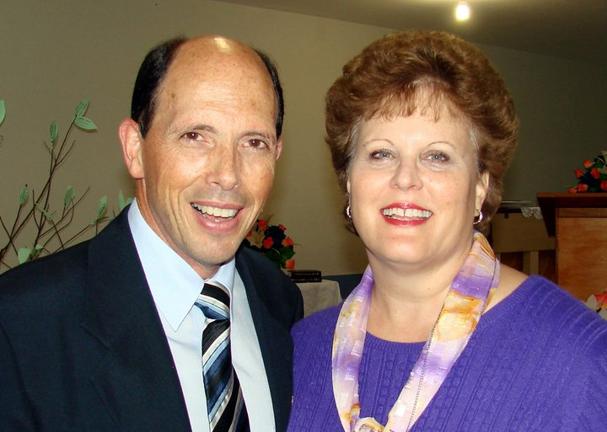
Graham and Renee’ Foran - Brazil

Slide 15
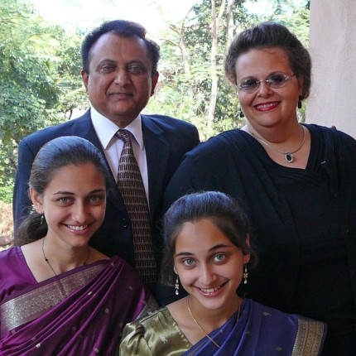
Harry and Cindyann Rasquinha - India

Slide 16
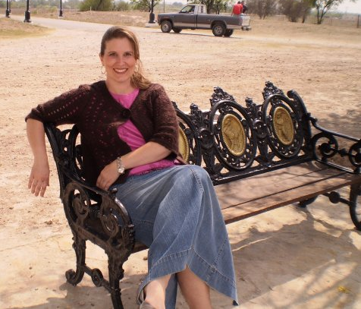
Heather Swearingin - Mexico

Slide 17
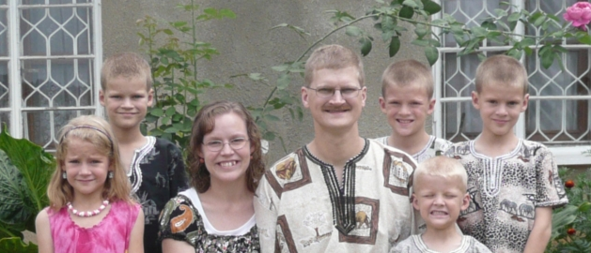
James and Anna Huckabee – Uganda

Slide 18
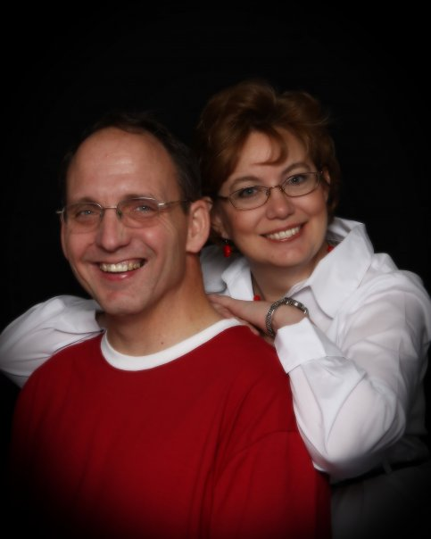
Keith and Brenda Price - Romania

Slide 19
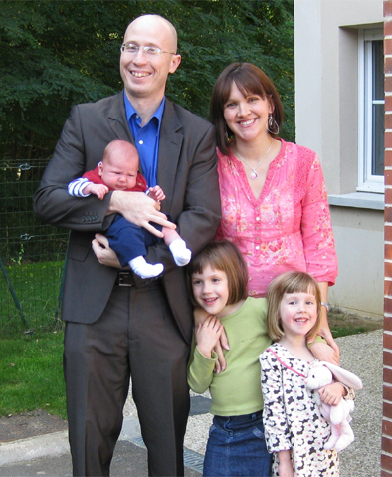
Lance and Amy Auterson - France

Slide 20
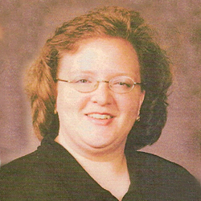
Lea Devers – Scotland

Slide 21
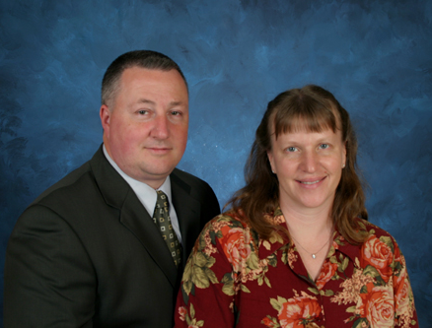
Mark and Anne Gostlin – French Redemption

Slide 22
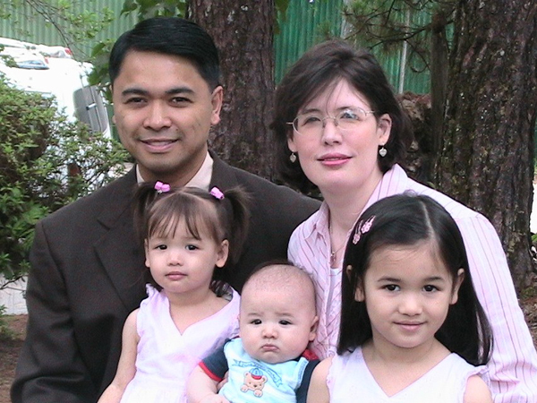
Mark and Kim Palmani – Philippines

Slide 23
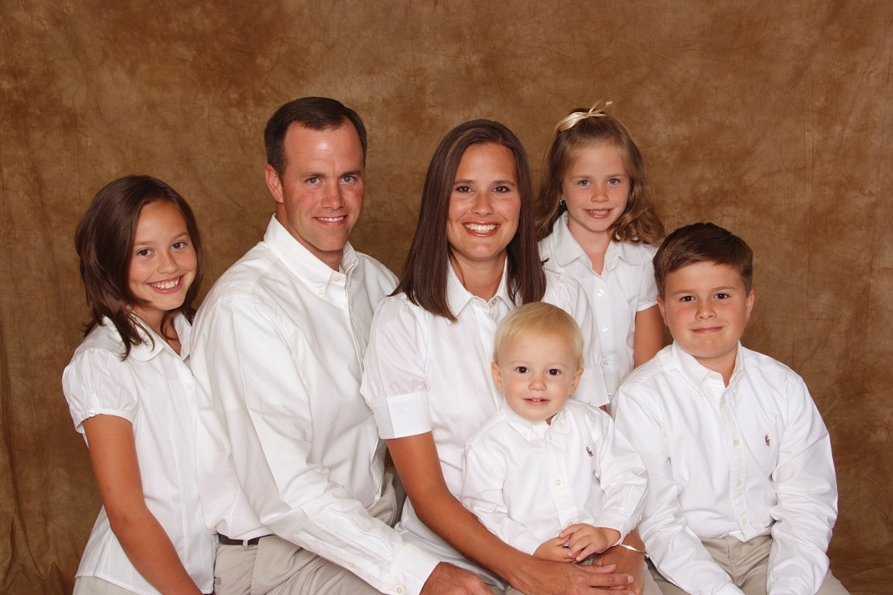
Matthew and Crystal Herrell - Peru

Slide 24
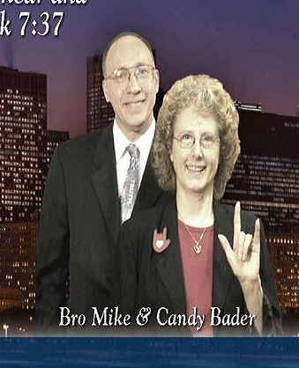
Mike and Candy Bader – U.S. Deaf Church Planting

Slide 25
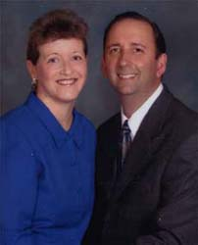
Mike and Cindy Burgett - Japan

Slide 26
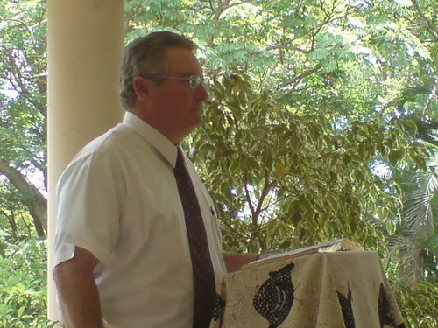
Richard and Laura Badgett – South Africa

Slide 27
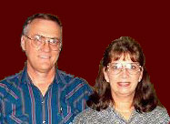
Richard and Joyce Crotts - Papua New Guinea

Slide 28
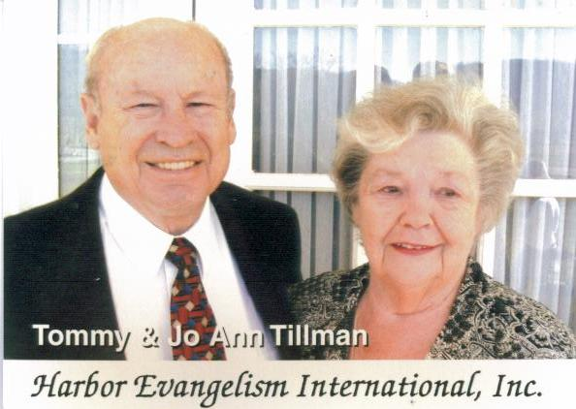
Tommy Tillman –
Thailand & Mongolia

Slide 29
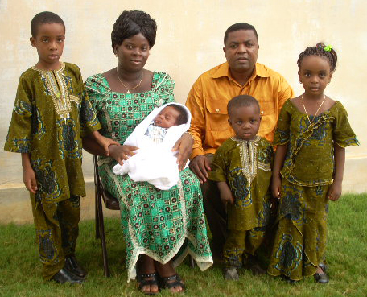
Vincent and Rose Agbodo - Togo

Slide 30
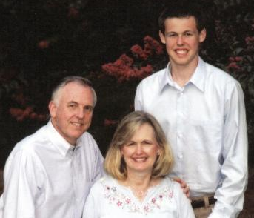
Wayne and Angela Harper – Australia

Slide 31
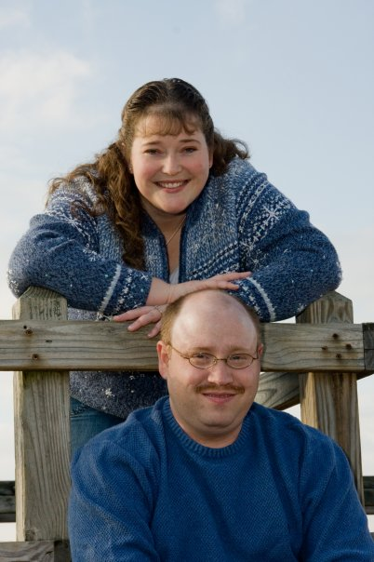
Will and LeAnn Vinson – Romania

