Slide 1

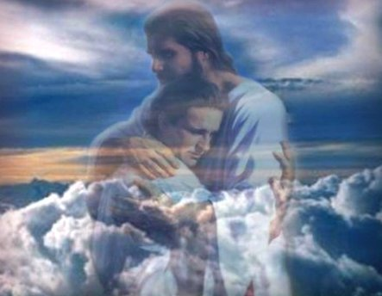
Amazing Grace Mission
Soul Winning

Slide 2
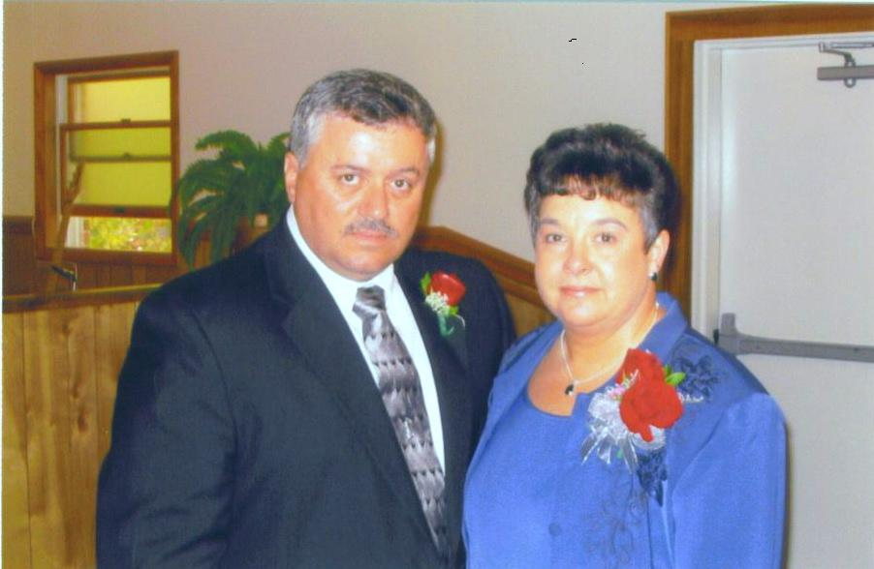
Buddy and Ann Walls - AGM

Slide 3
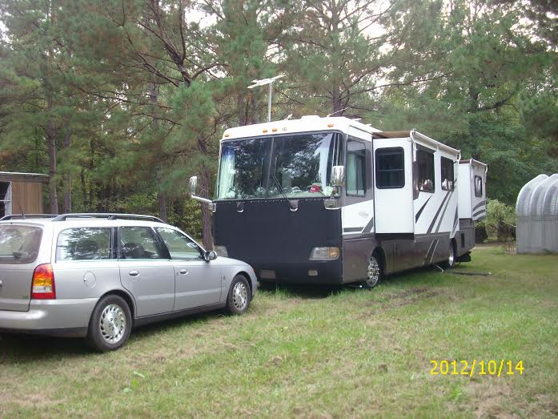
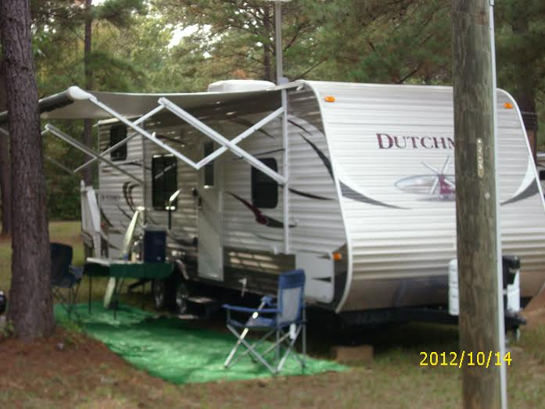
We travel with an RV to County and State Fairs and market places across the United States setting up soul winning booths
Ralph & Linda Copeland
AGM Missionaries
Through the reading of the Word of God, and by the work of the Holy Spirit people can be saved
Buddy & Ann Walls
AGM Missionaries

Slide 4
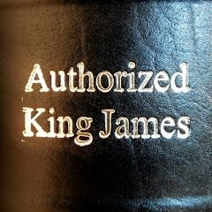

Slide 5


Slide 6


Slide 7


Slide 8
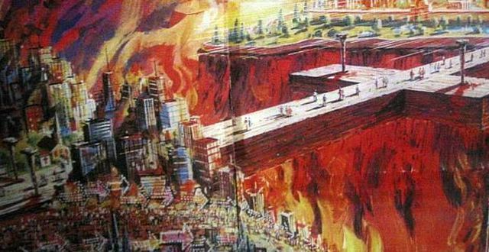

Slide 9
Are you 100% sure you’re going to heaven?
If they give you anything less than a 100% say (God wants you to know)
1John 5:13; that ye may know that ye have eternal life
The Lord wants you to know that ye have eternal life when you accept him as Savior

Slide 10
We take them down the Romans Road
GOD SAYS THAT NONE ARE GOOD Rom 3:10 As it is written, There is none righteous, no, not one:
GOD SAYS THAT ALL ARE SINNERS Rom 3:23 For all have sinned, and come short of the glory of God;
GOD TELL US THE REASON ALL ARE SINNERS
Rom 5:12 Wherefore, as by one man sin entered into the world, and death by sin; and so death passed upon all men, for that all have sinned:
GOD TELLS US THE RESULT OF SIN
Rom 6:23 For the wages of sin is death; but the gift of God is eternal life through Jesus Christ our Lord.
GOD TELLS US OF HIS CONCERN FOR SINNERS
Rom 5:8 But God commendeth his love toward us, in that, while we were yet sinners, Christ died for us.
GOD’S WAY OF SALVATION IS MADE PLAIN
Rom 10:9 That if thou shalt confess with thy mouth the Lord Jesus, and shalt believe in thine heart that God hath raised him from the dead, thou shalt be saved.
Rom 10:10 For with the heart man believeth unto righteousness; and with the mouth confession is made unto salvation

Slide 11
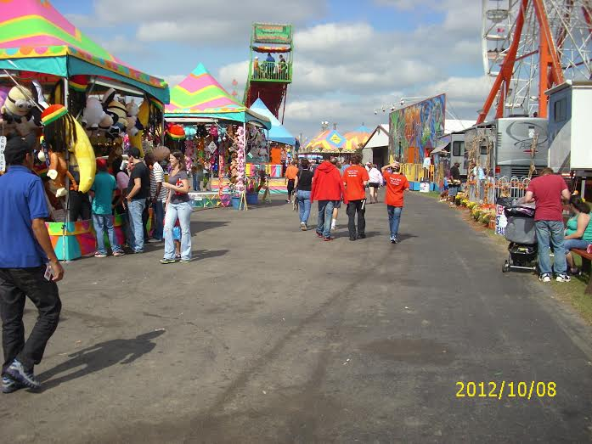
Wise Virginia Fair

Slide 12
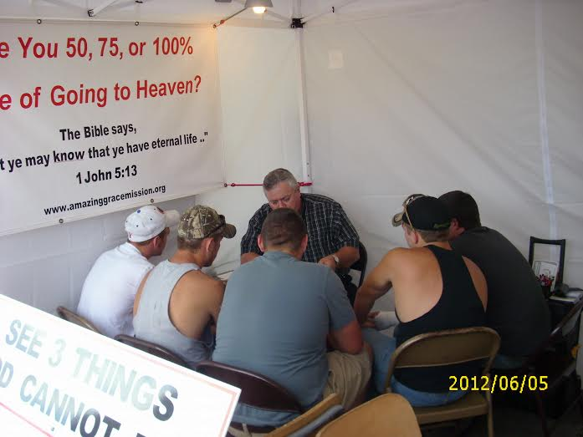
Soul Winning
Buddy Walls leading five young men to the Lord

Slide 13
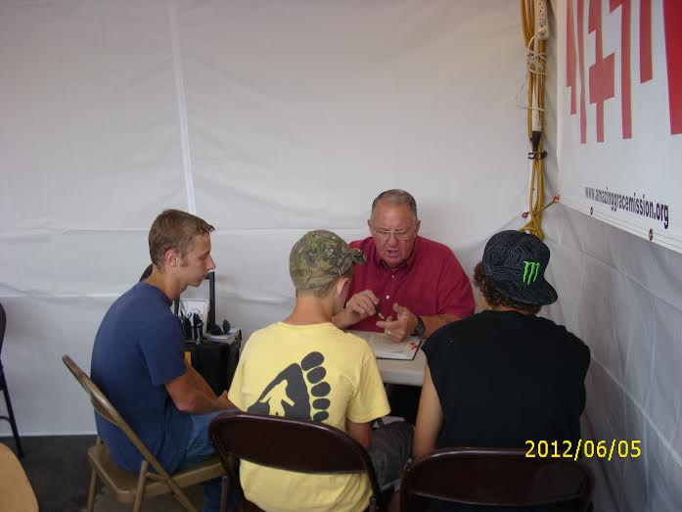
Ralph Copeland leading three young men to the Lord

Slide 14
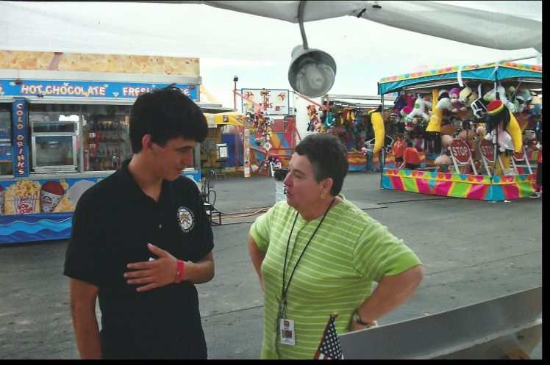
Perry Georgia

Slide 15
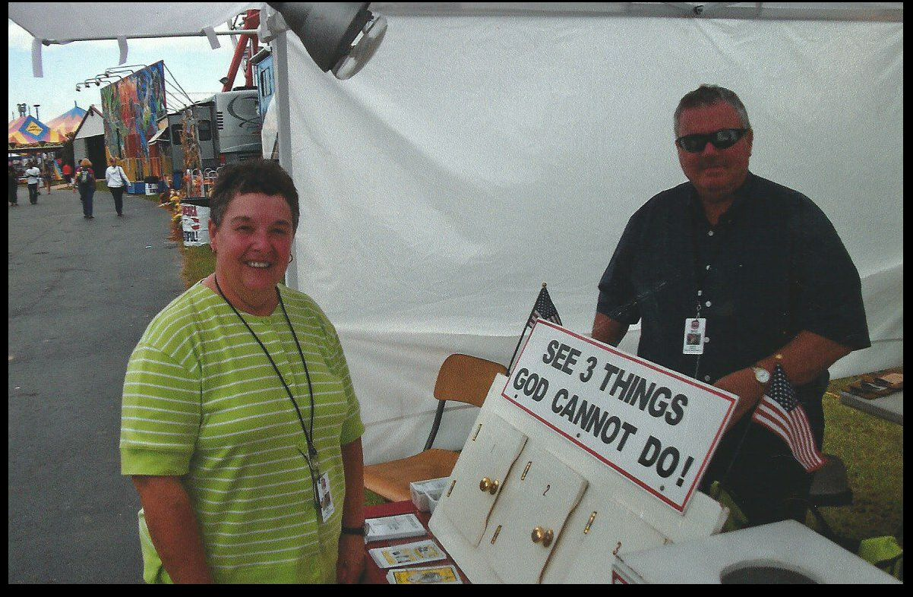
Perry Georgia

Slide 16
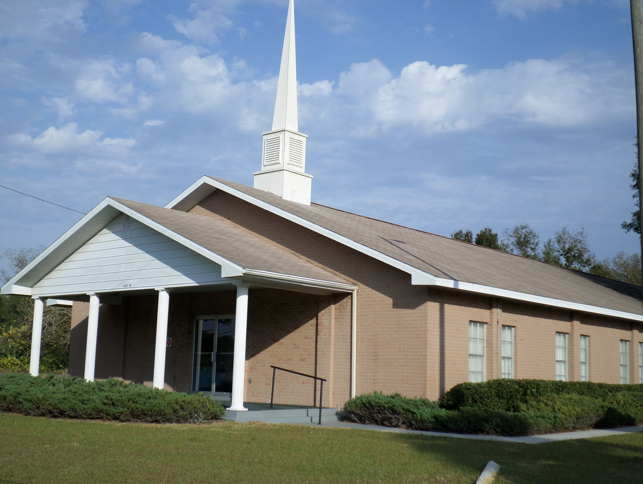
Conference Meeting
Bible Baptist
Seffner Florida

Slide 17
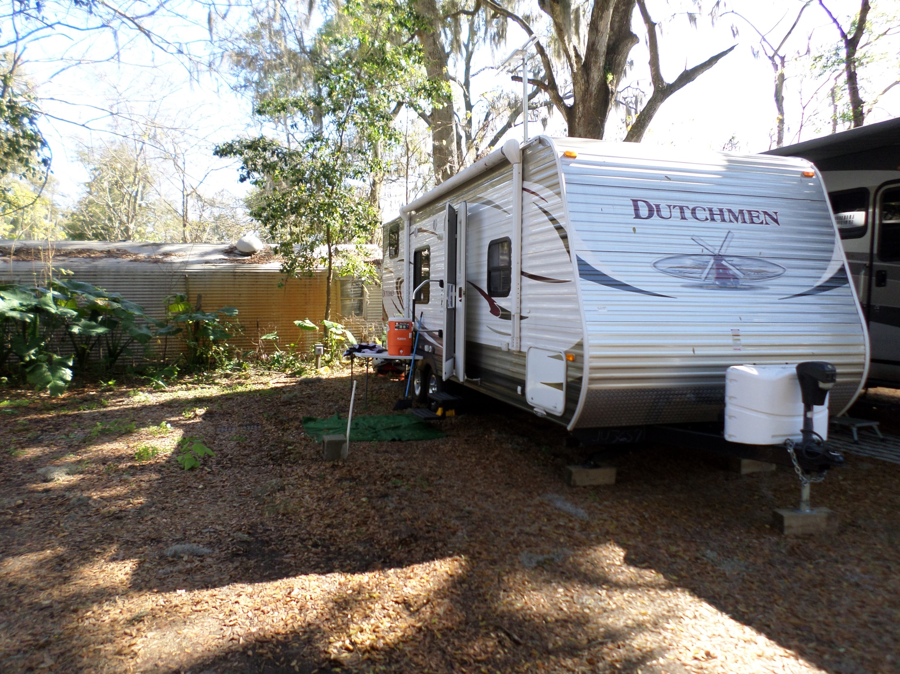
AGM campground Seffner Florida

Slide 18
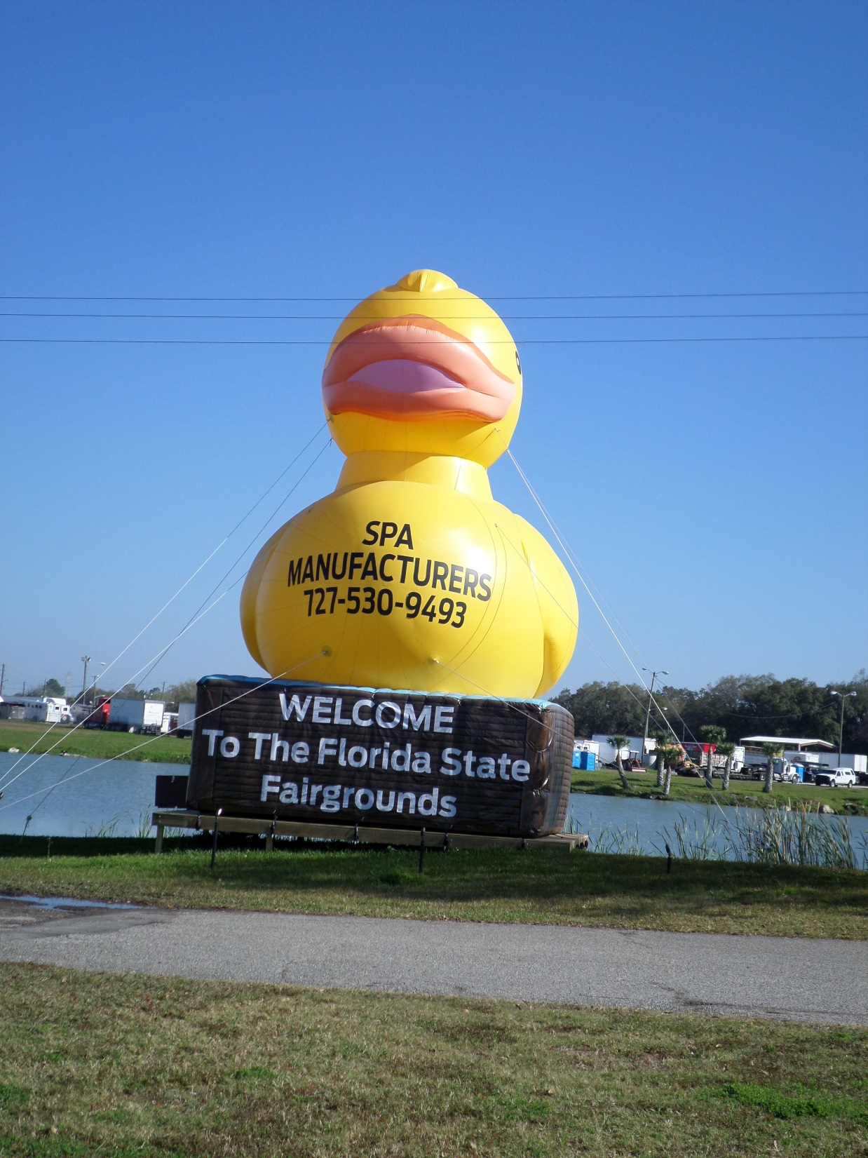
Tampa Florida

Slide 19
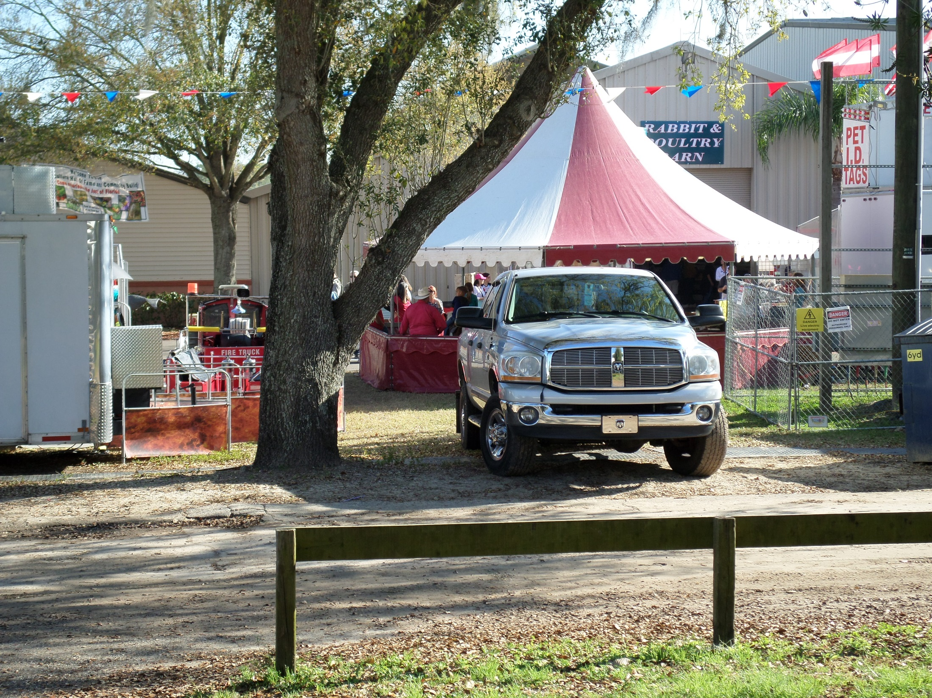

Slide 20
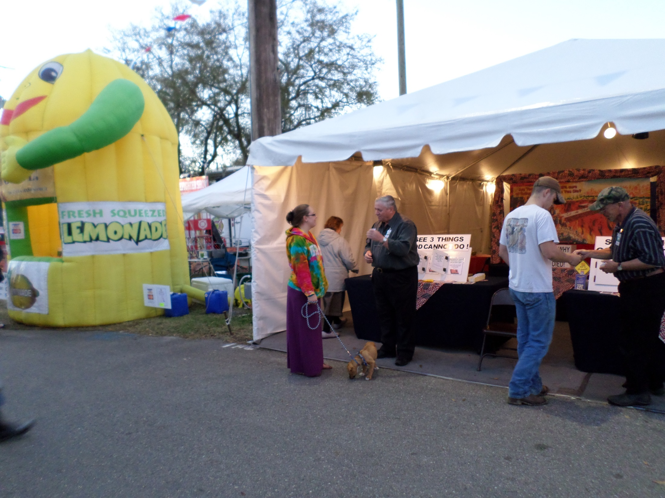

Slide 21
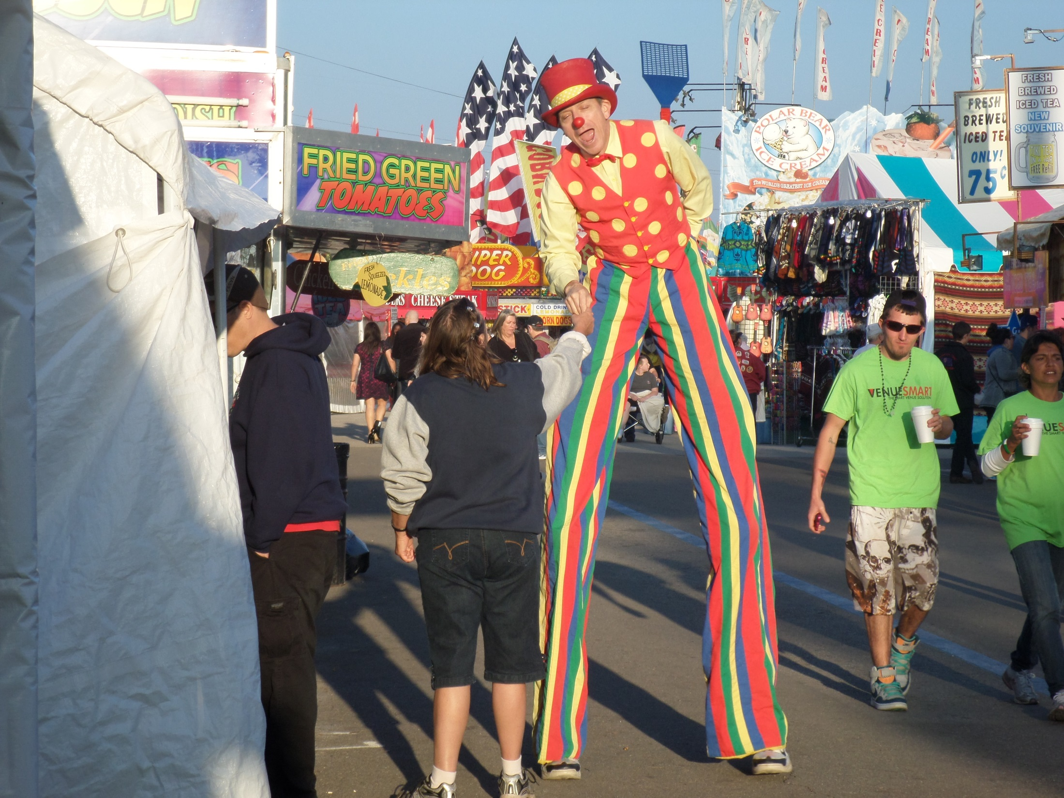
Tampa Fl.
Fair

Slide 22
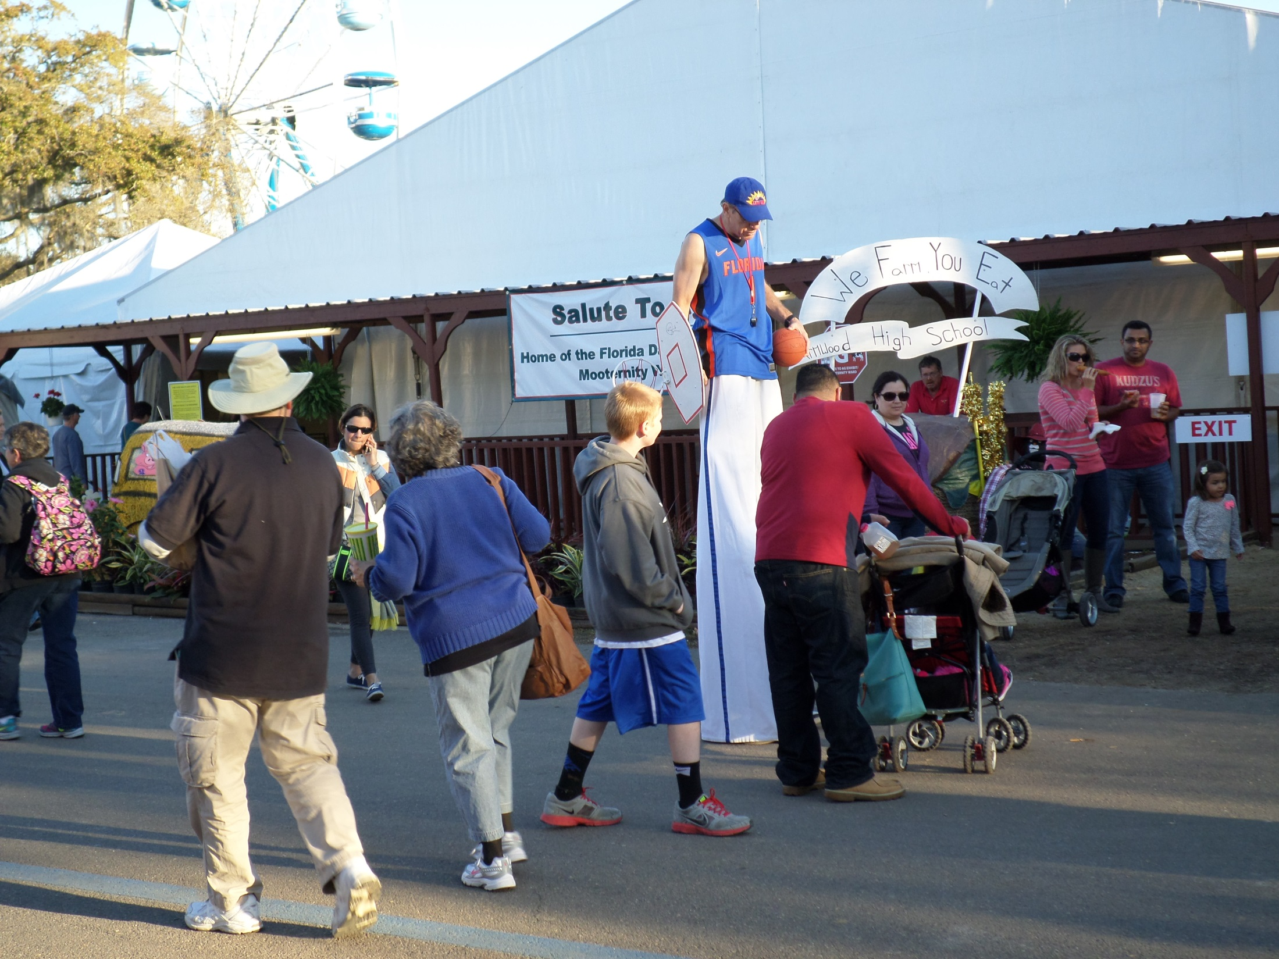

Slide 23
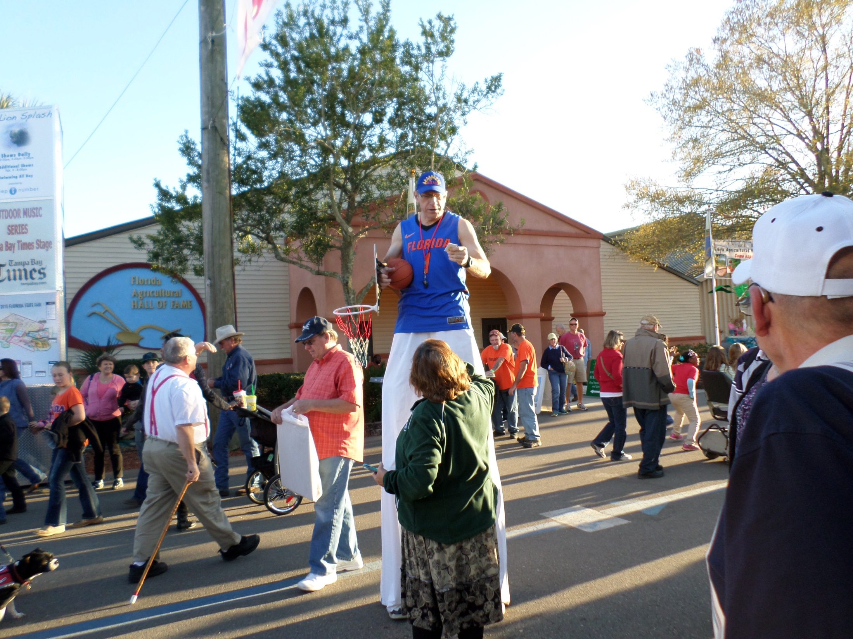

Slide 24
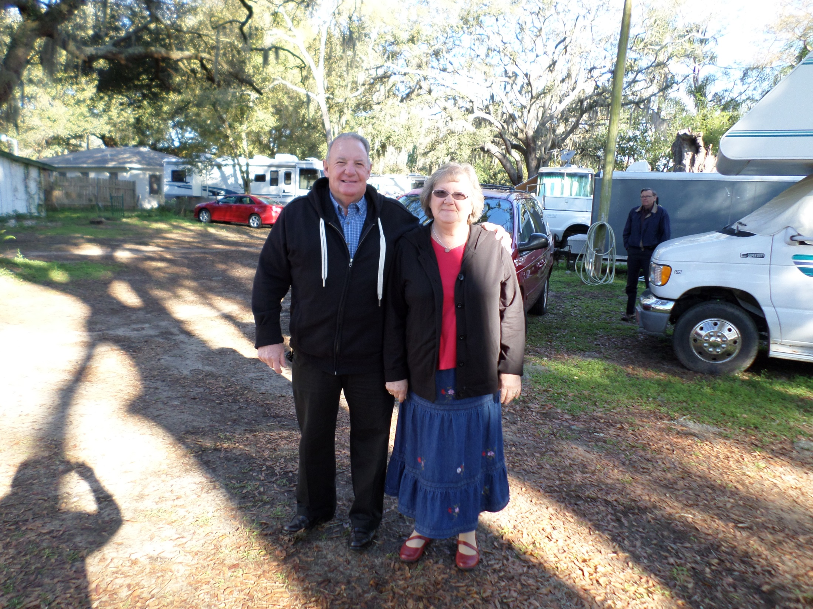
Ralph and Linda Copeland
AGM Missionaries

Slide 25
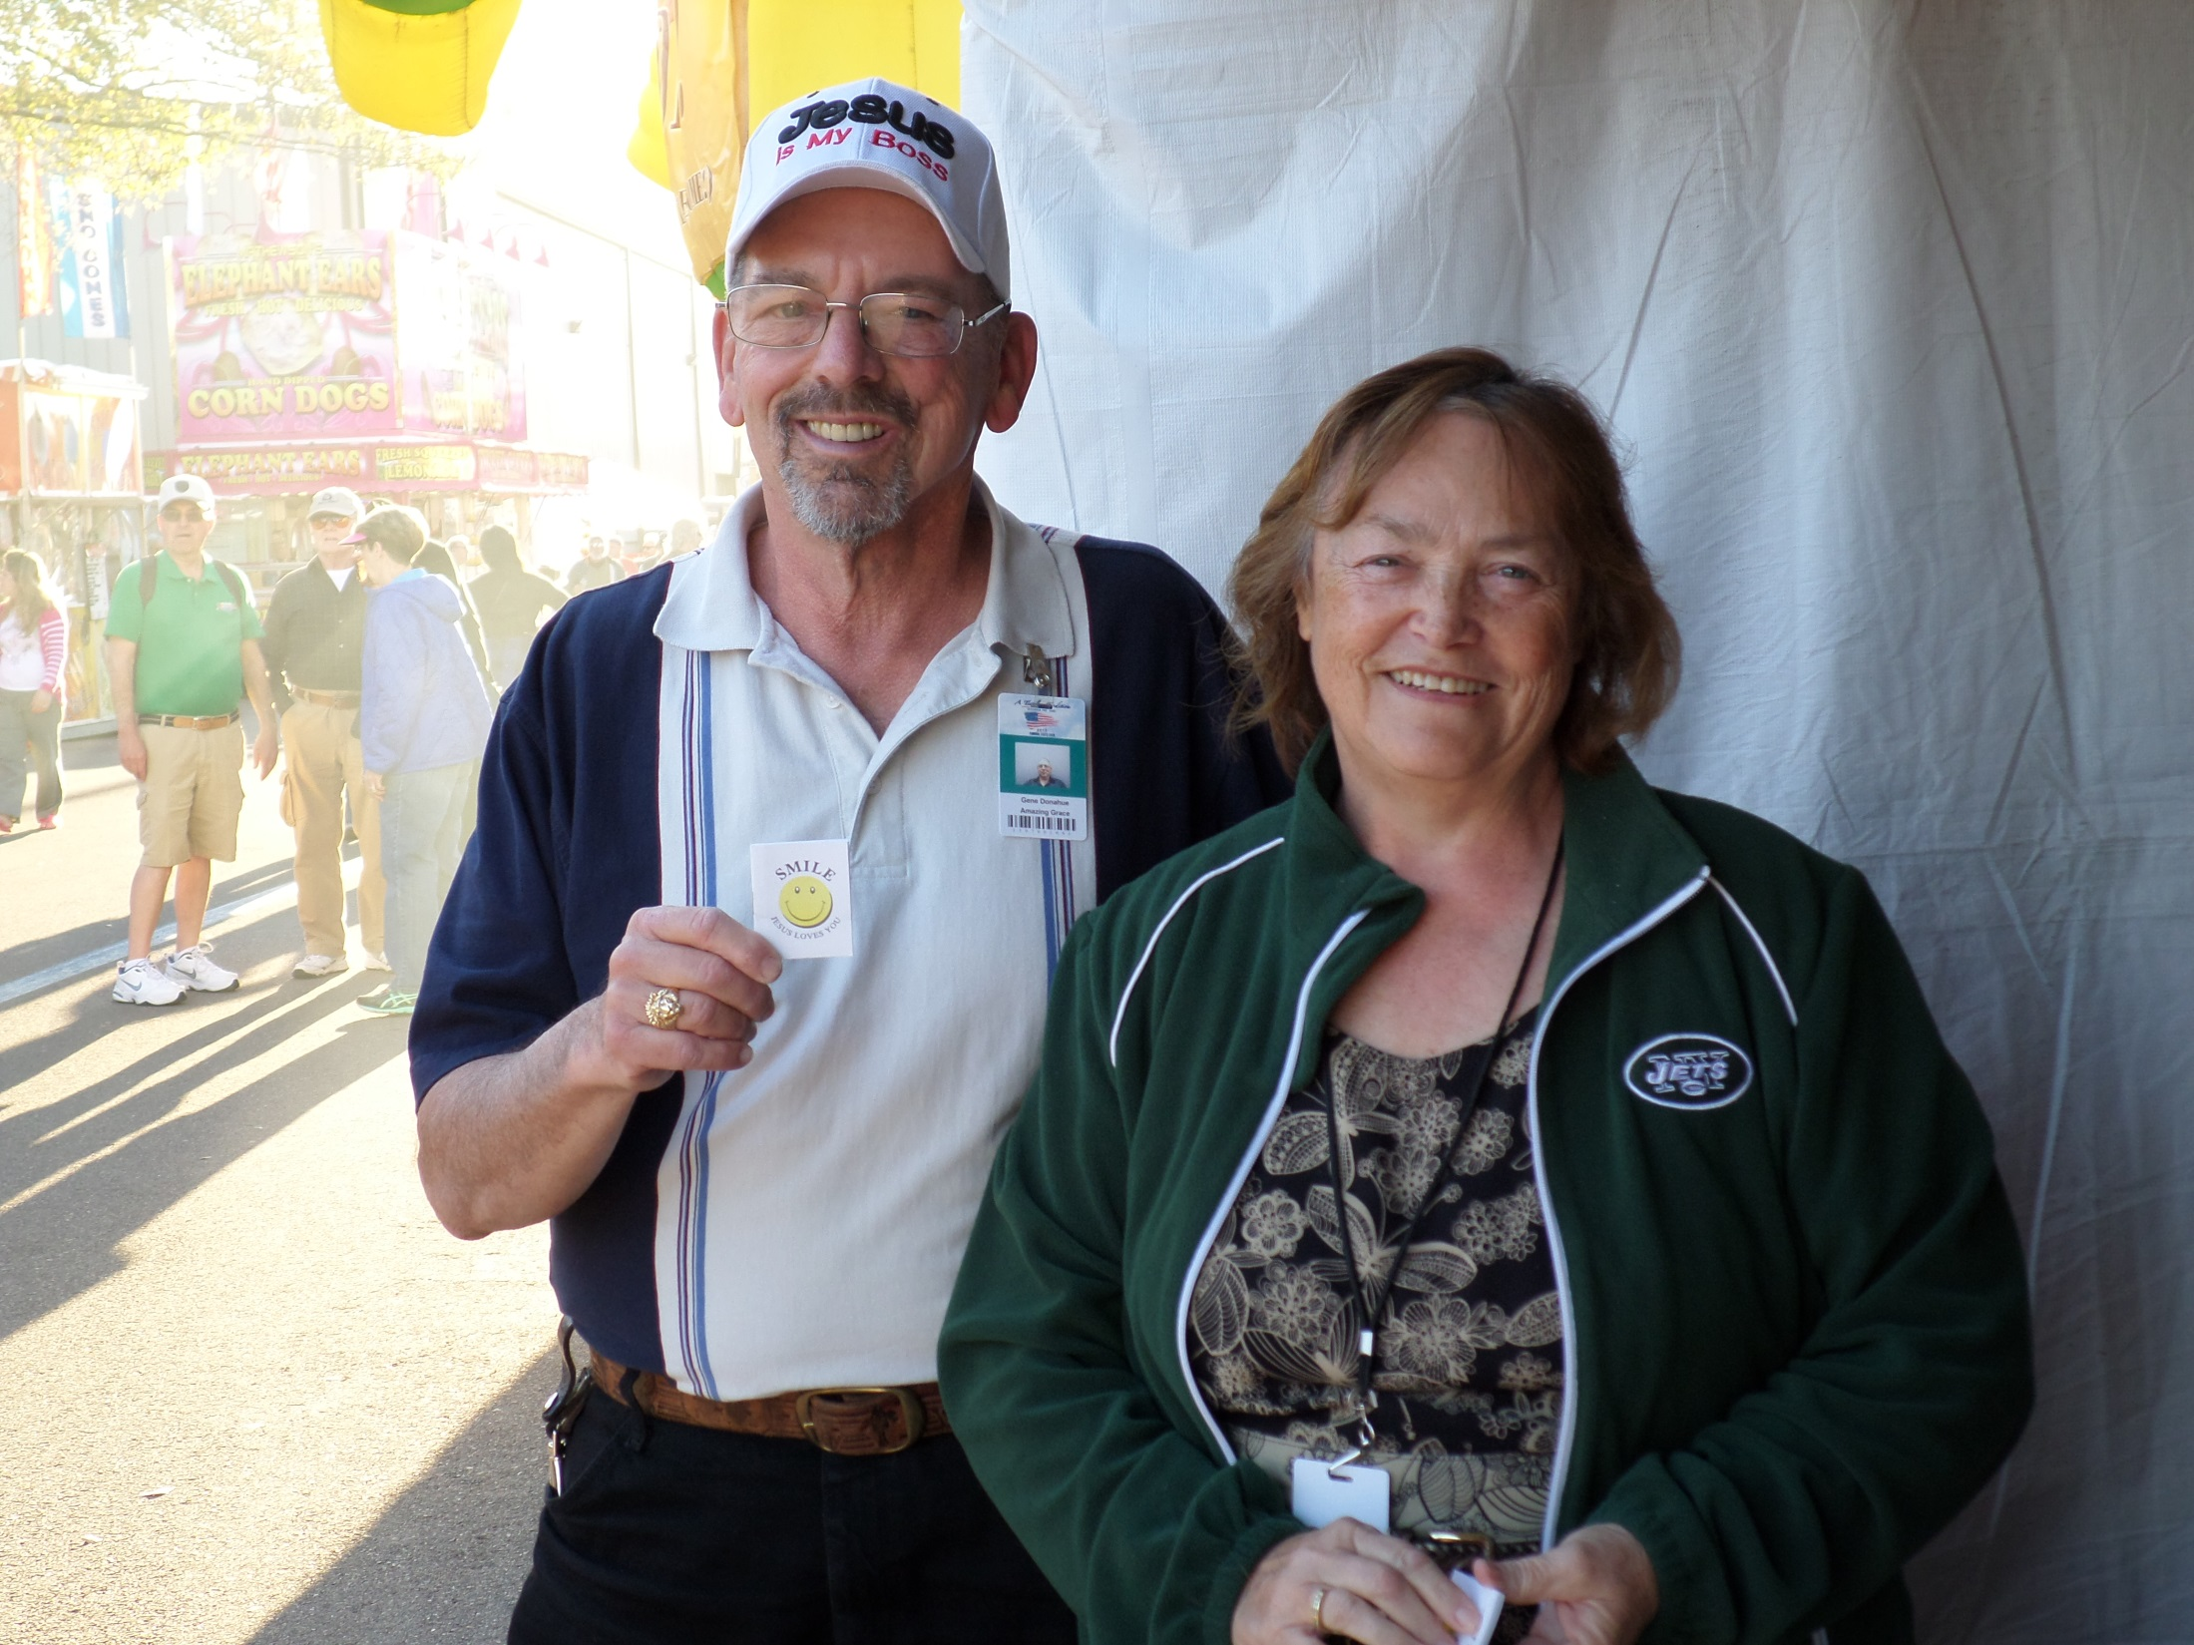
Gene and Joann Donahue
AGM Missionaries

Slide 26
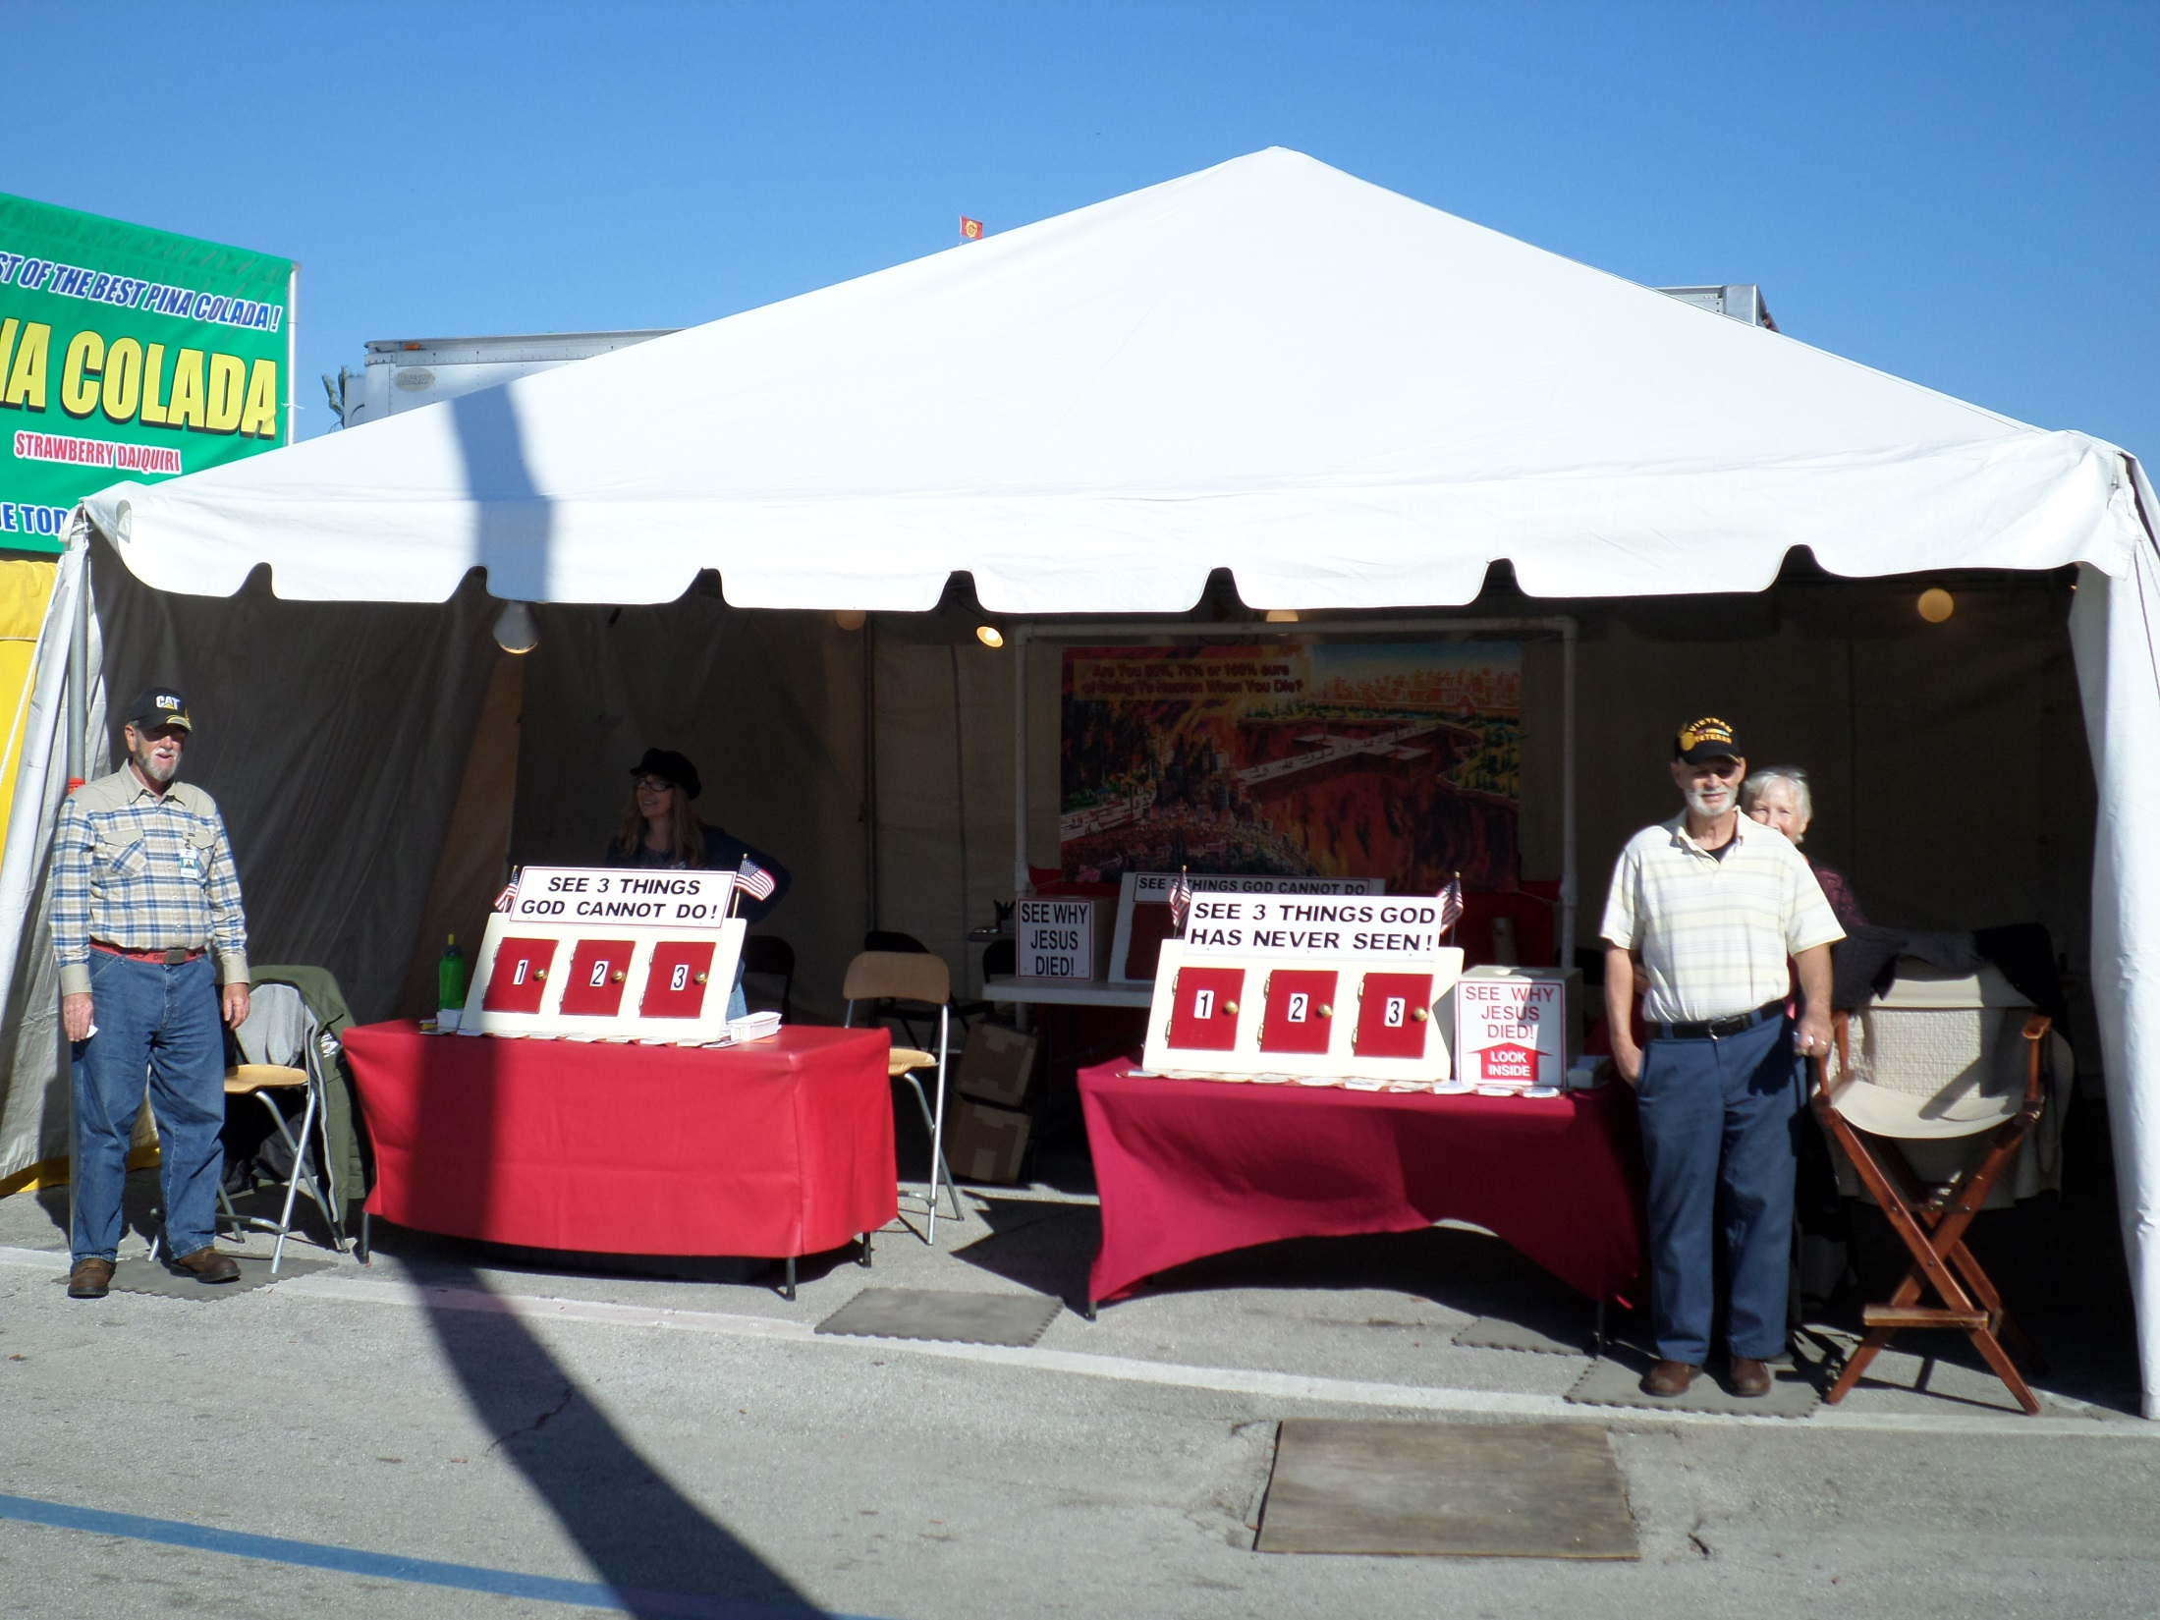

Slide 27
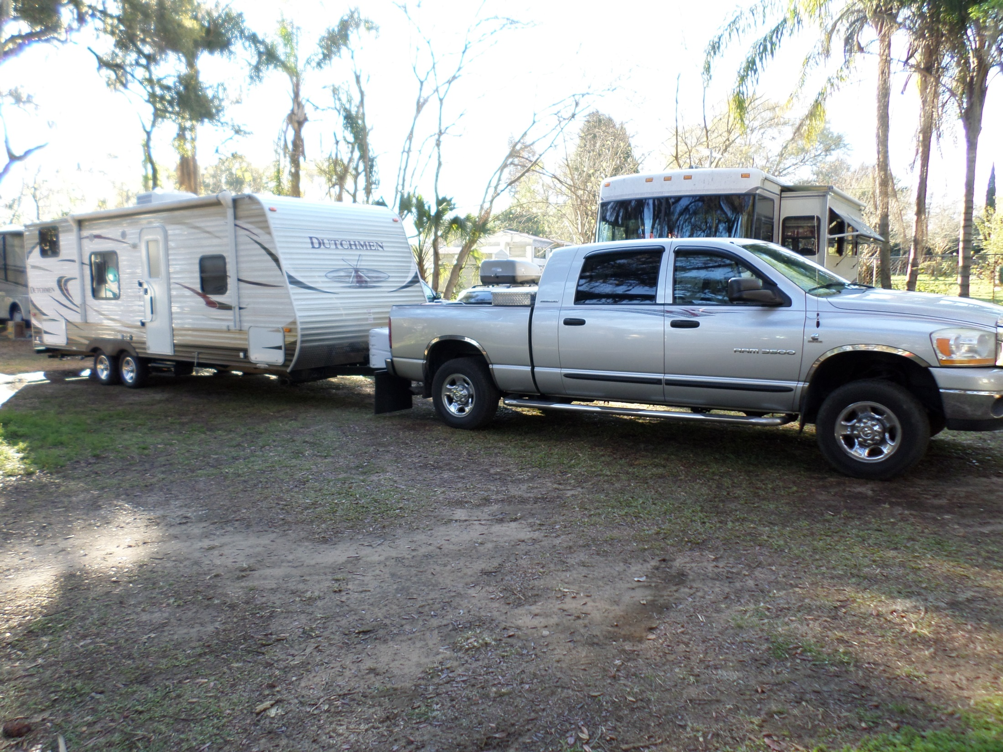
Leaving Tampa Fl. For Bryson City NC

Slide 28
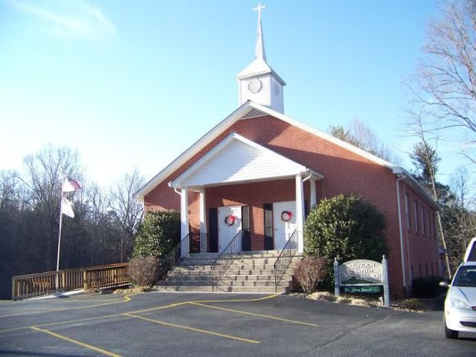
Arlington Baptist

Slide 29
Buddy and Ann Walls
Amazing Grace Mission 184 Walls Lane Bryson City, NC 28713
Home: Cell: 828-371-5586/342-6894
Website: tweagle3.wix.com/saved
E-mail: tweagle3@gmail.com
Sending Church: Arlington Baptist
670 Hughes Br. Rd. Bryson City NC 28713
Church website: www.arlingtonbaptistchurchbc.com
Prayer Cards available

