Slide 1



Amazing Grace Mission
Soul Winning
For America

Slide 2
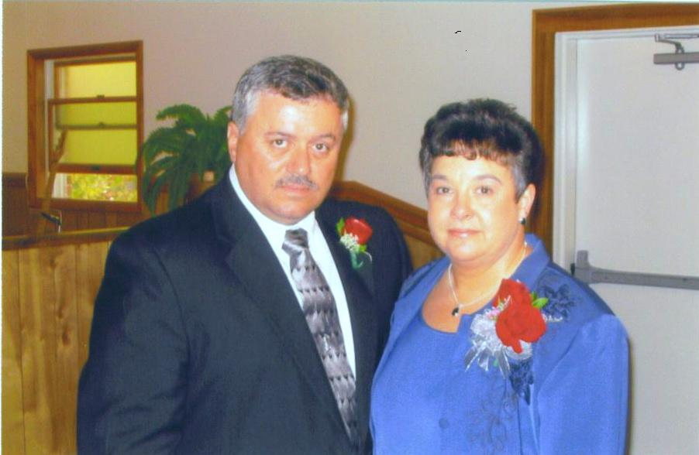
Buddy and Ann Walls - AGM

Slide 3
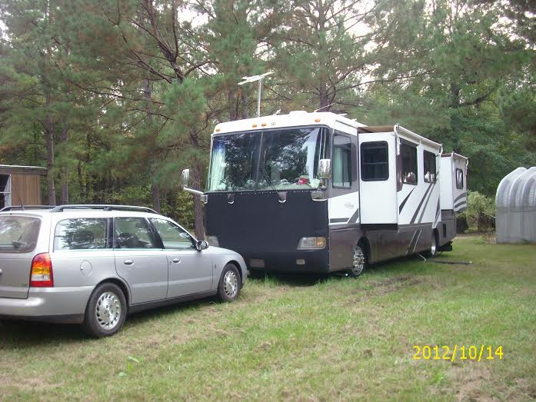
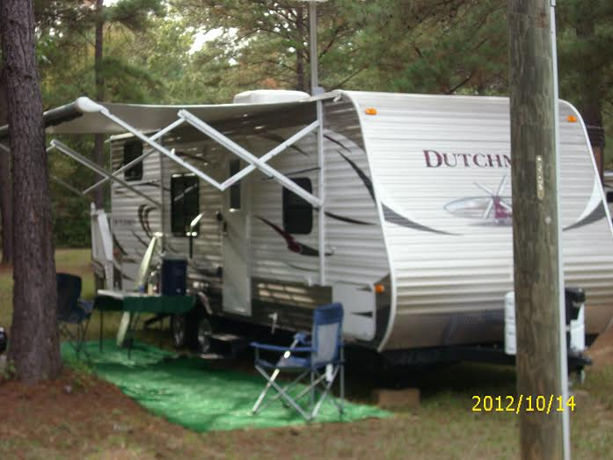
We travel with an RV to County and State Fairs and market places across the United States setting up soul winning booths
Ralph & Linda Copeland
AGM Missionaries
Through the reading of the Word of God, and by the work of the Holy Spirit people can be saved
Buddy & Ann Walls
AGM Missionaries

Slide 4
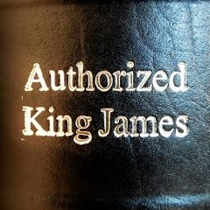

Slide 5


Slide 6
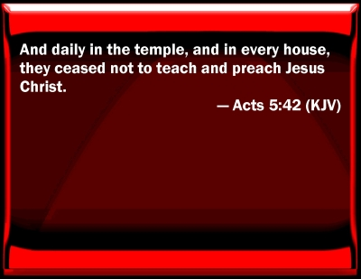
Soul Winning

Slide 7
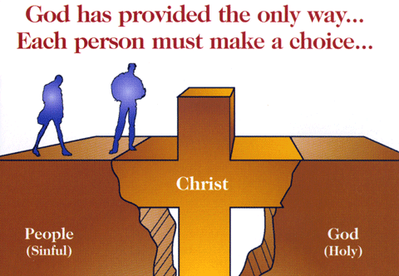

Slide 8
Are you 100% sure you’re going to heaven?
If they give you anything less than a 100% say (God wants you to know)
1John 5:13; that ye may know that ye have eternal life
The Lord wants you to know that ye have eternal life when you accept him as Savior

Slide 9
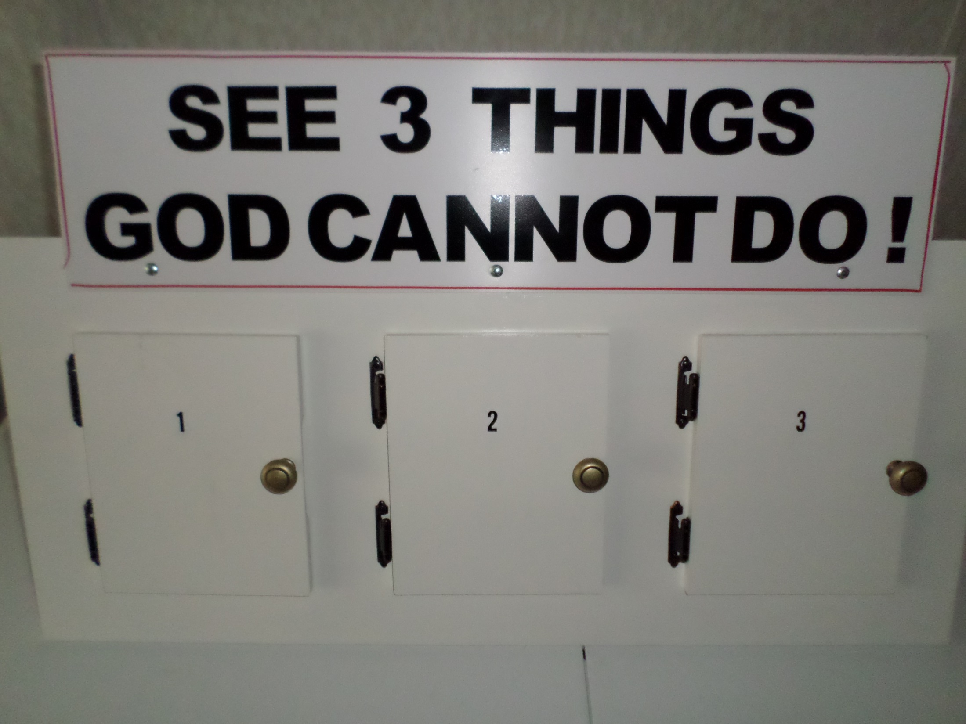

Slide 10
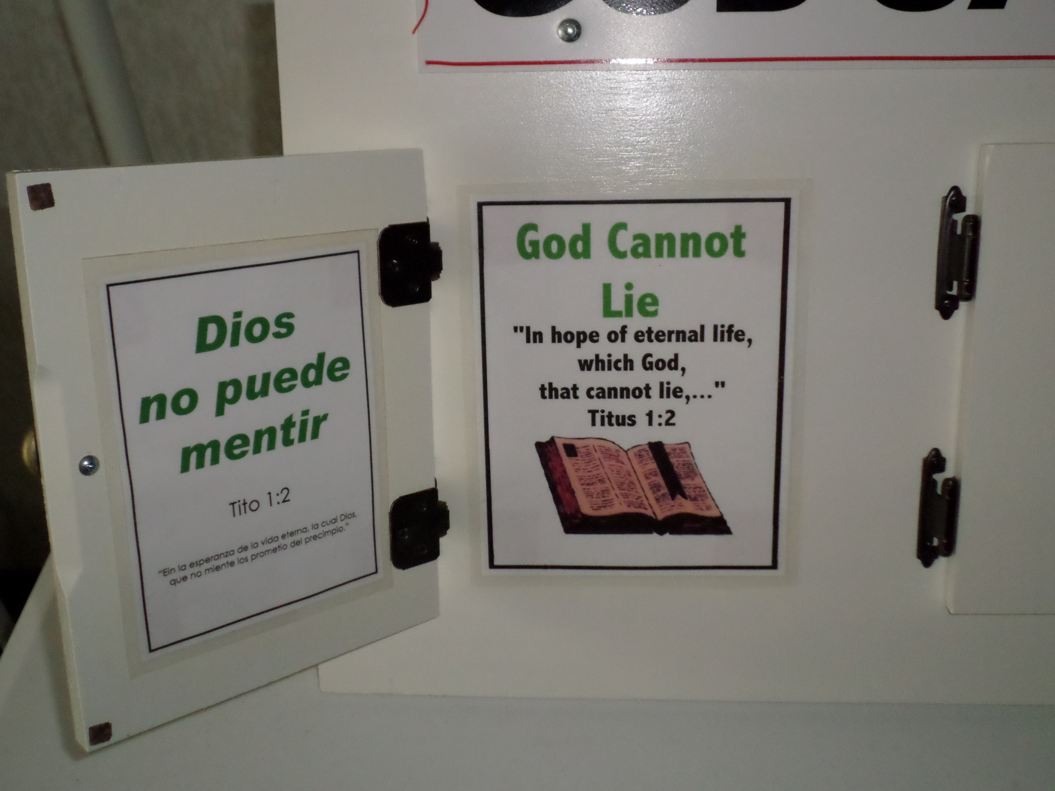

Slide 11
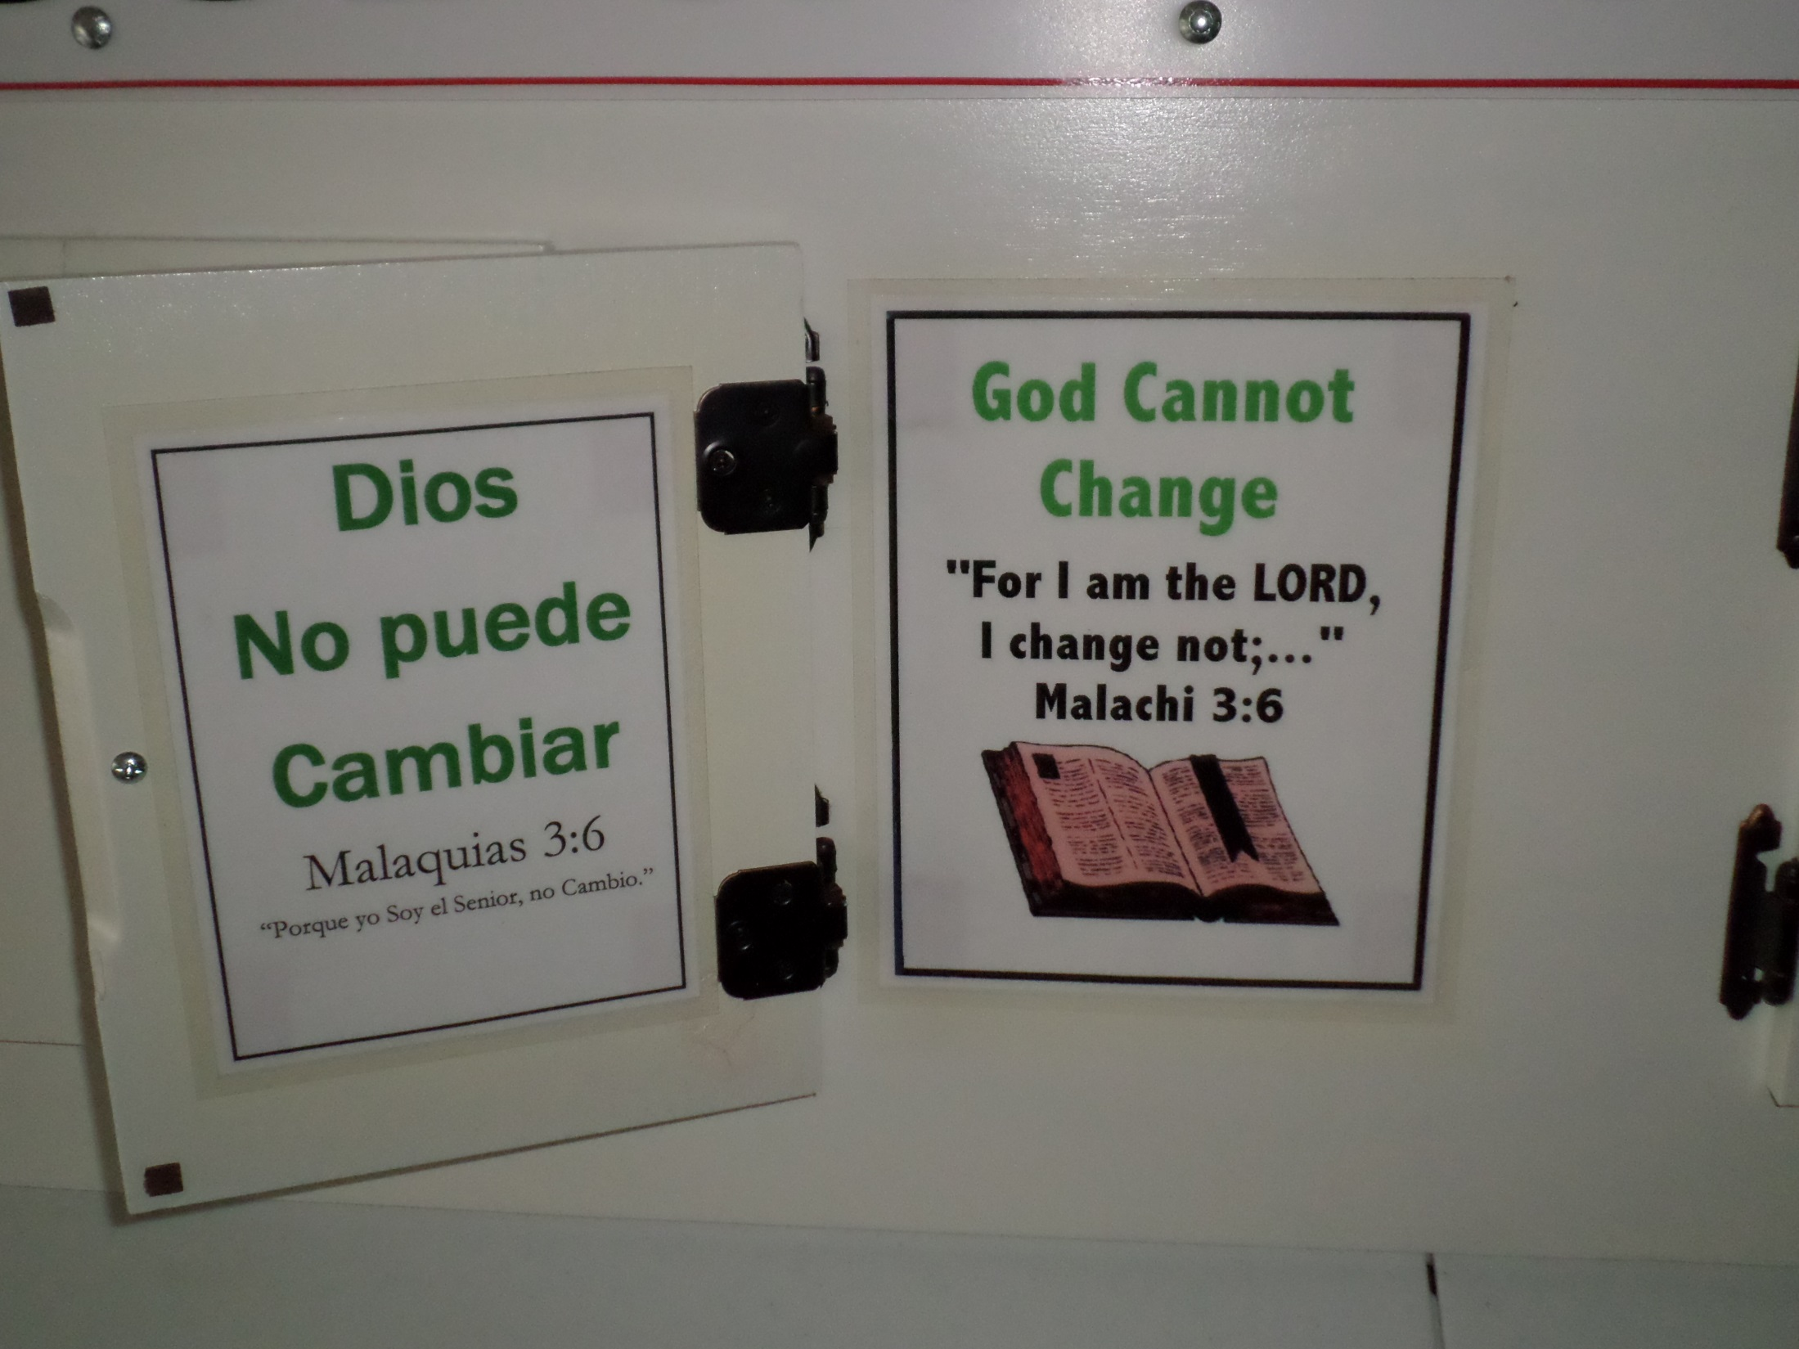

Slide 12
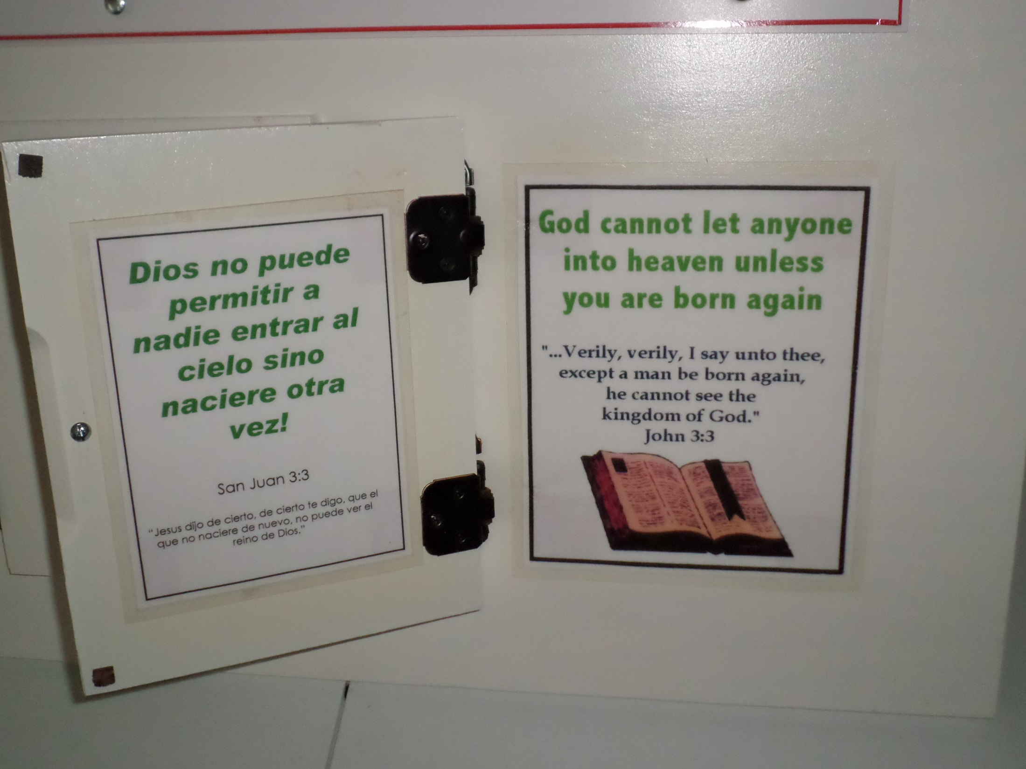

Slide 13
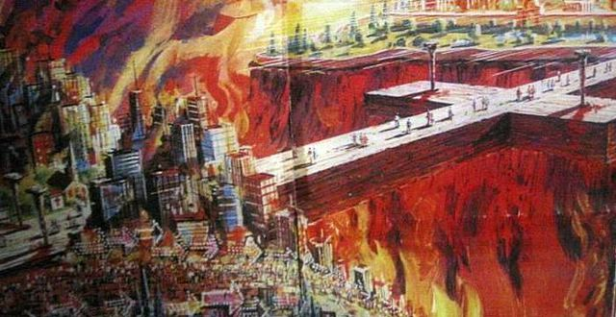

Slide 14
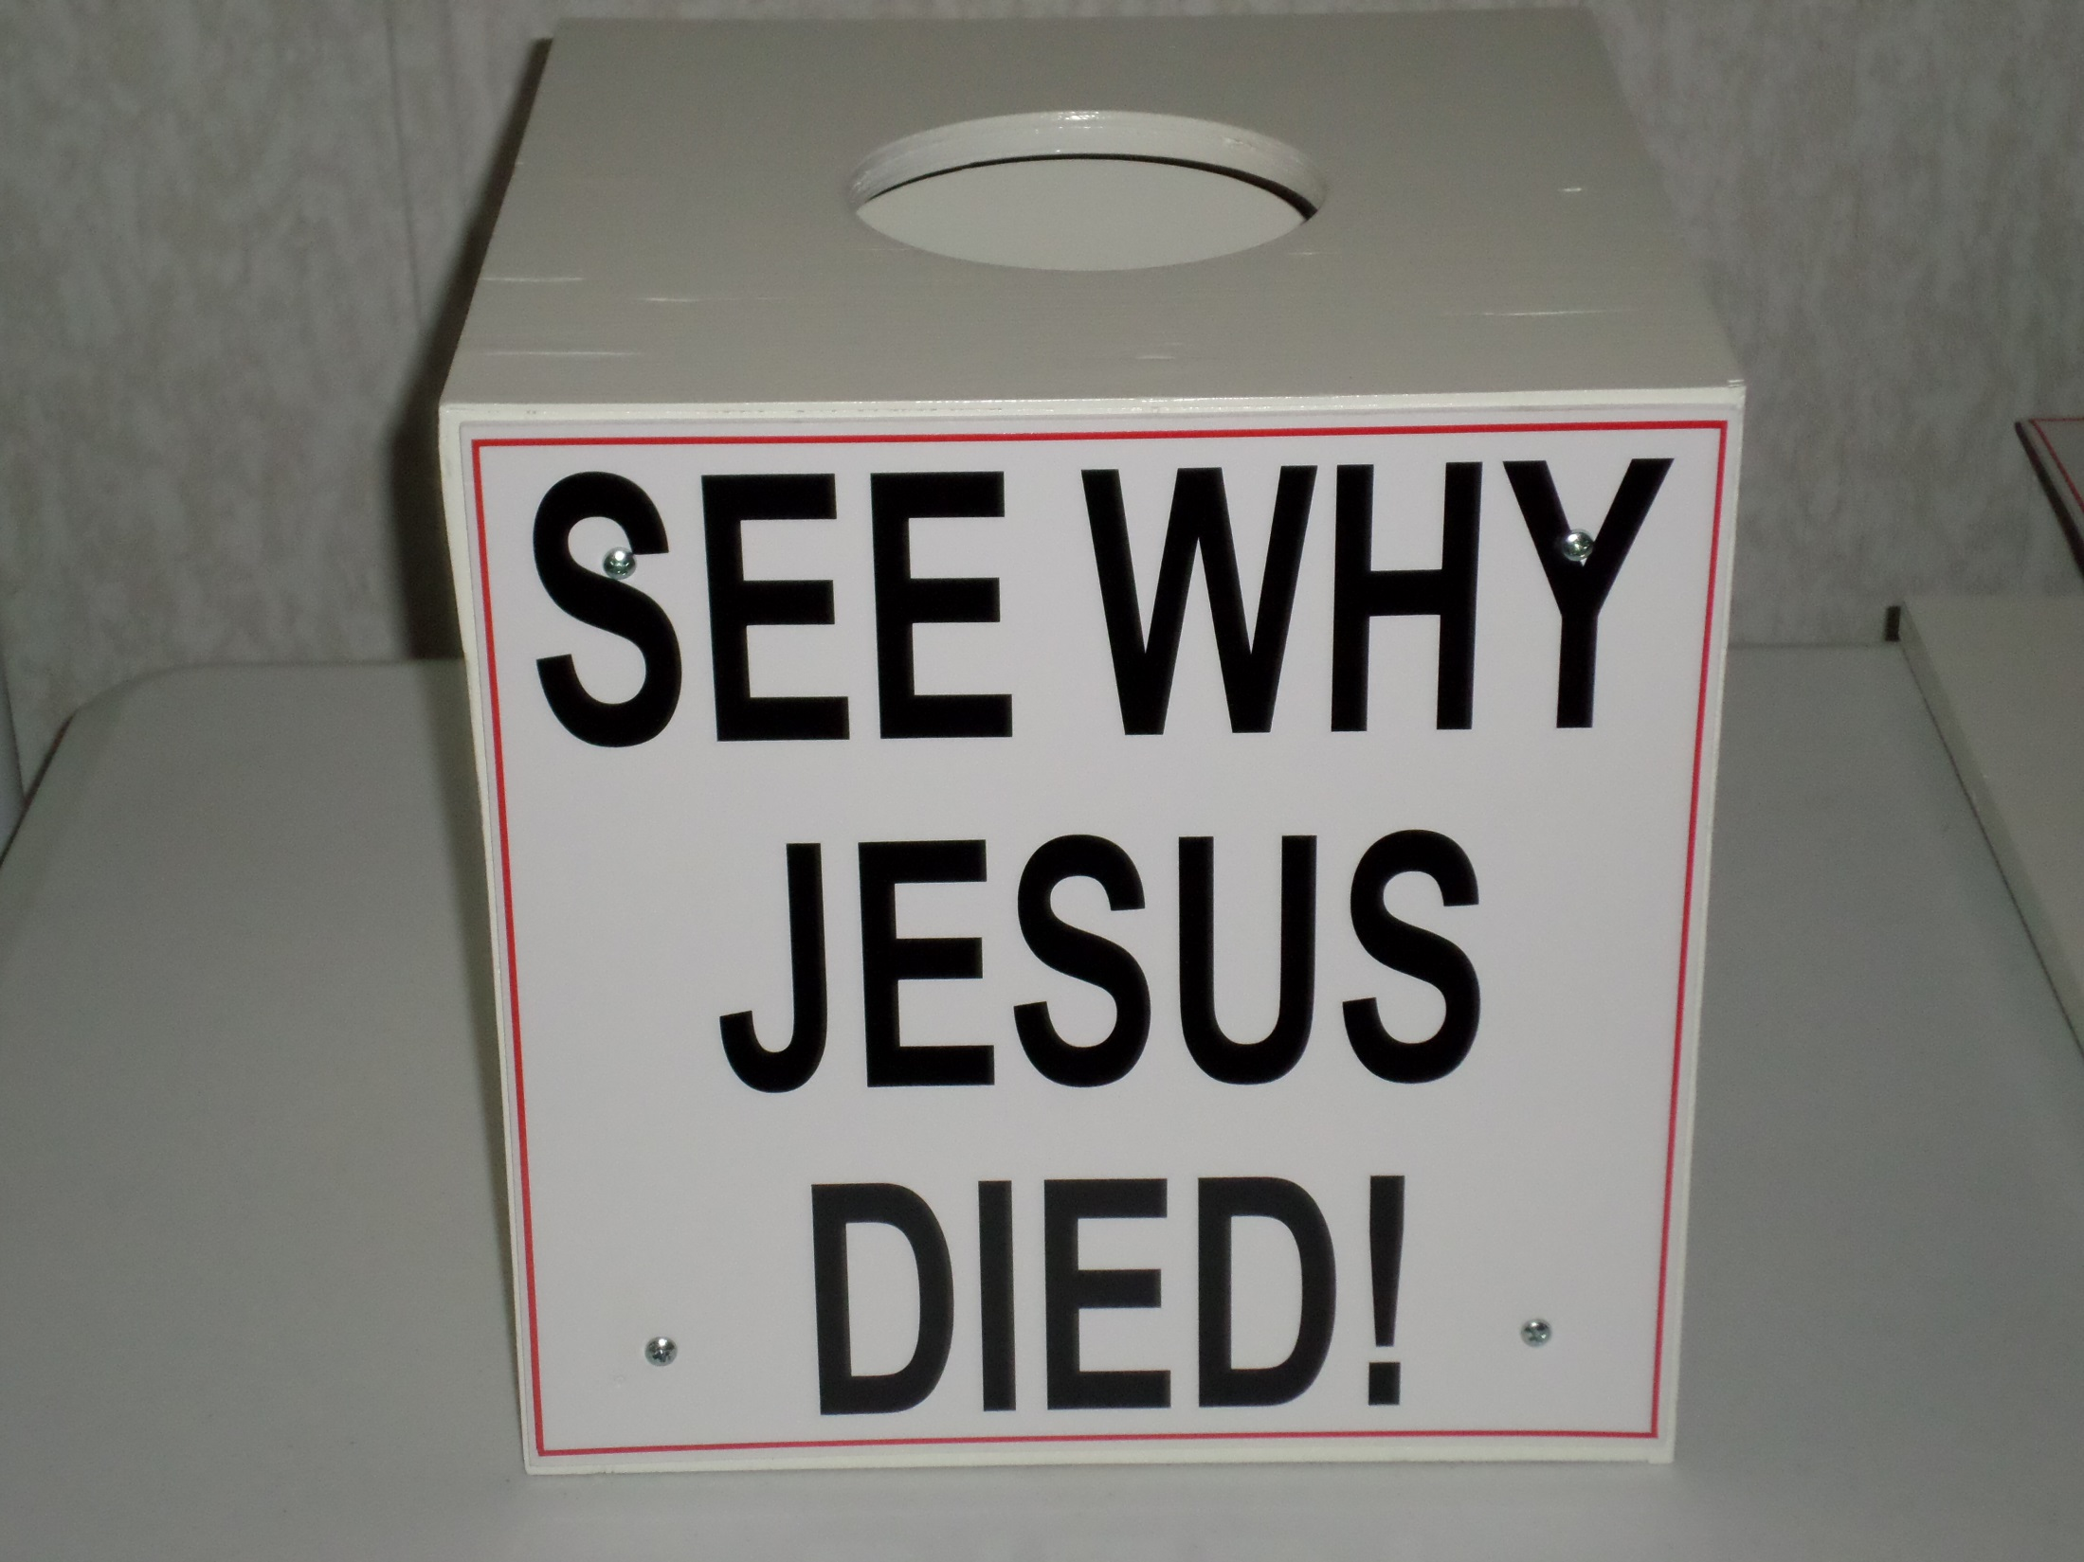

Slide 15
We take them down the Romans Road
GOD SAYS THAT NONE ARE GOOD Rom 3:10 As it is written, There is none righteous, no, not one:
GOD SAYS THAT ALL ARE SINNERS Rom 3:23 For all have sinned, and come short of the glory of God;
GOD TELL US THE REASON ALL ARE SINNERS
Rom 5:12 Wherefore, as by one man sin entered into the world, and death by sin; and so death passed upon all men, for that all have sinned:
GOD TELLS US THE RESULT OF SIN
Rom 6:23 For the wages of sin is death; but the gift of God is eternal life through Jesus Christ our Lord.
GOD TELLS US OF HIS CONCERN FOR SINNERS
Rom 5:8 But God commendeth his love toward us, in that, while we were yet sinners, Christ died for us.
GOD’S WAY OF SALVATION IS MADE PLAIN
Rom 10:9 That if thou shalt confess with thy mouth the Lord Jesus, and shalt believe in thine heart that God hath raised him from the dead, thou shalt be saved.
Rom 10:10 For with the heart man believeth unto righteousness; and with the mouth confession is made unto salvation

Slide 16
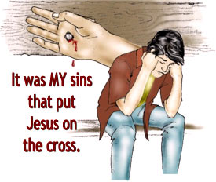
Repentance – A change of mind
God, I have NO desire to practice SIN.

Slide 17
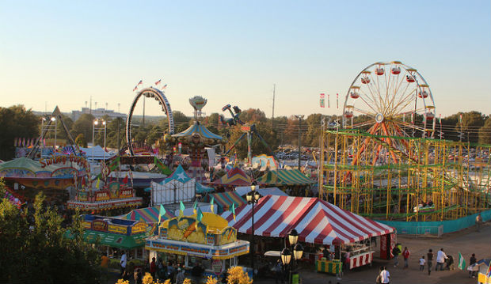
Fayetteville North Carolina – September 2012
124 led to the Lord

Slide 18
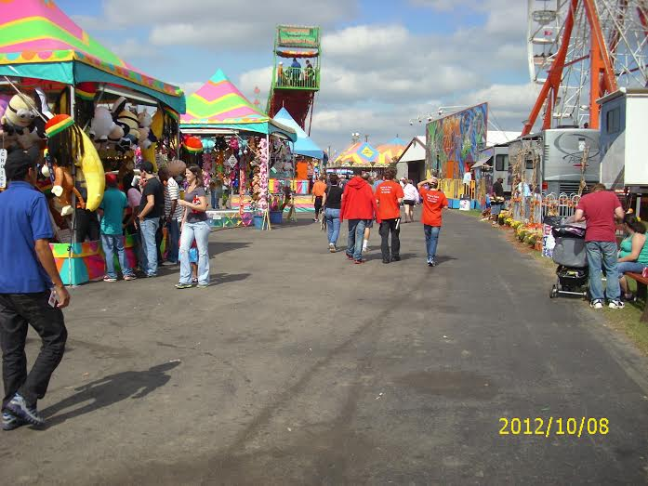
Wise Virginia Fair
212 led to the Lord

Slide 19
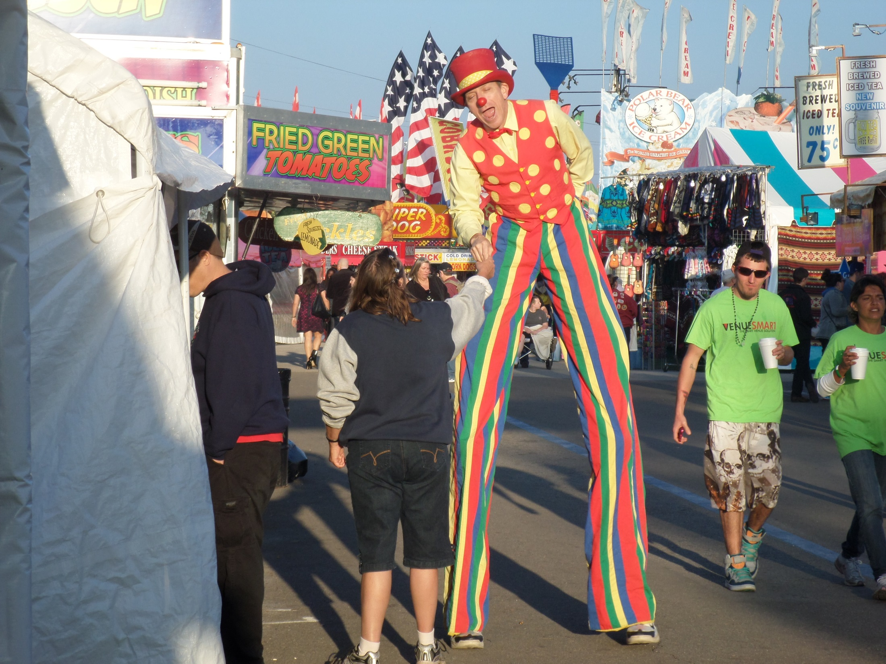
Tampa Fl.
Fair
609
led
to the
Lord
Year 2015

Slide 20
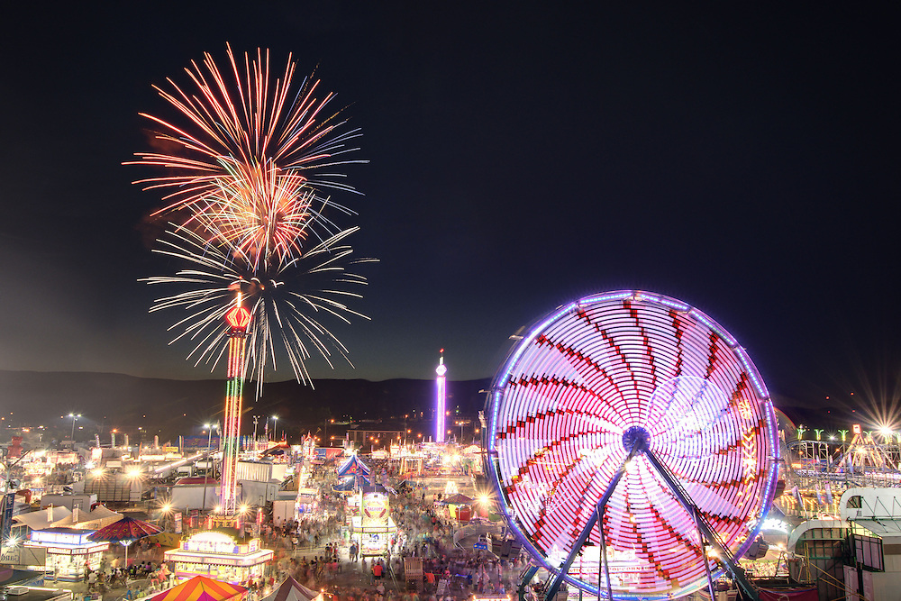
Salem Virginia Fair year 2012
651 people led to the Lord

Slide 21
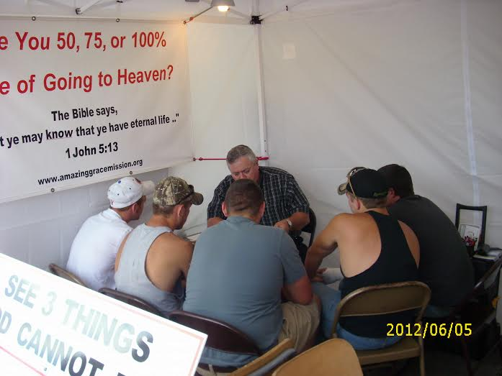
Soul Winning
Buddy Walls leading five young men to the Lord

Slide 22
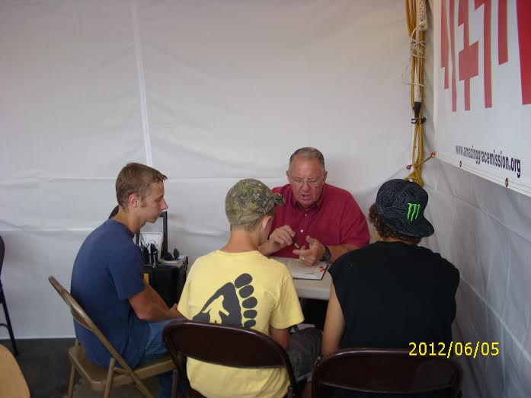
Ralph Copeland leading three young men to the Lord

Slide 23
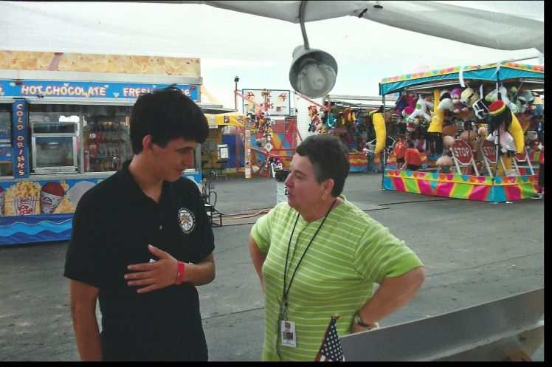
Perry Georgia

Slide 24
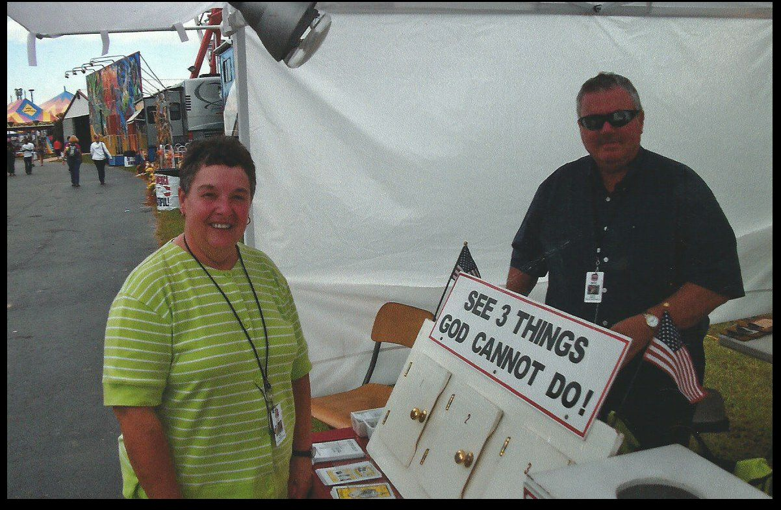
Perry Georgia

Slide 25
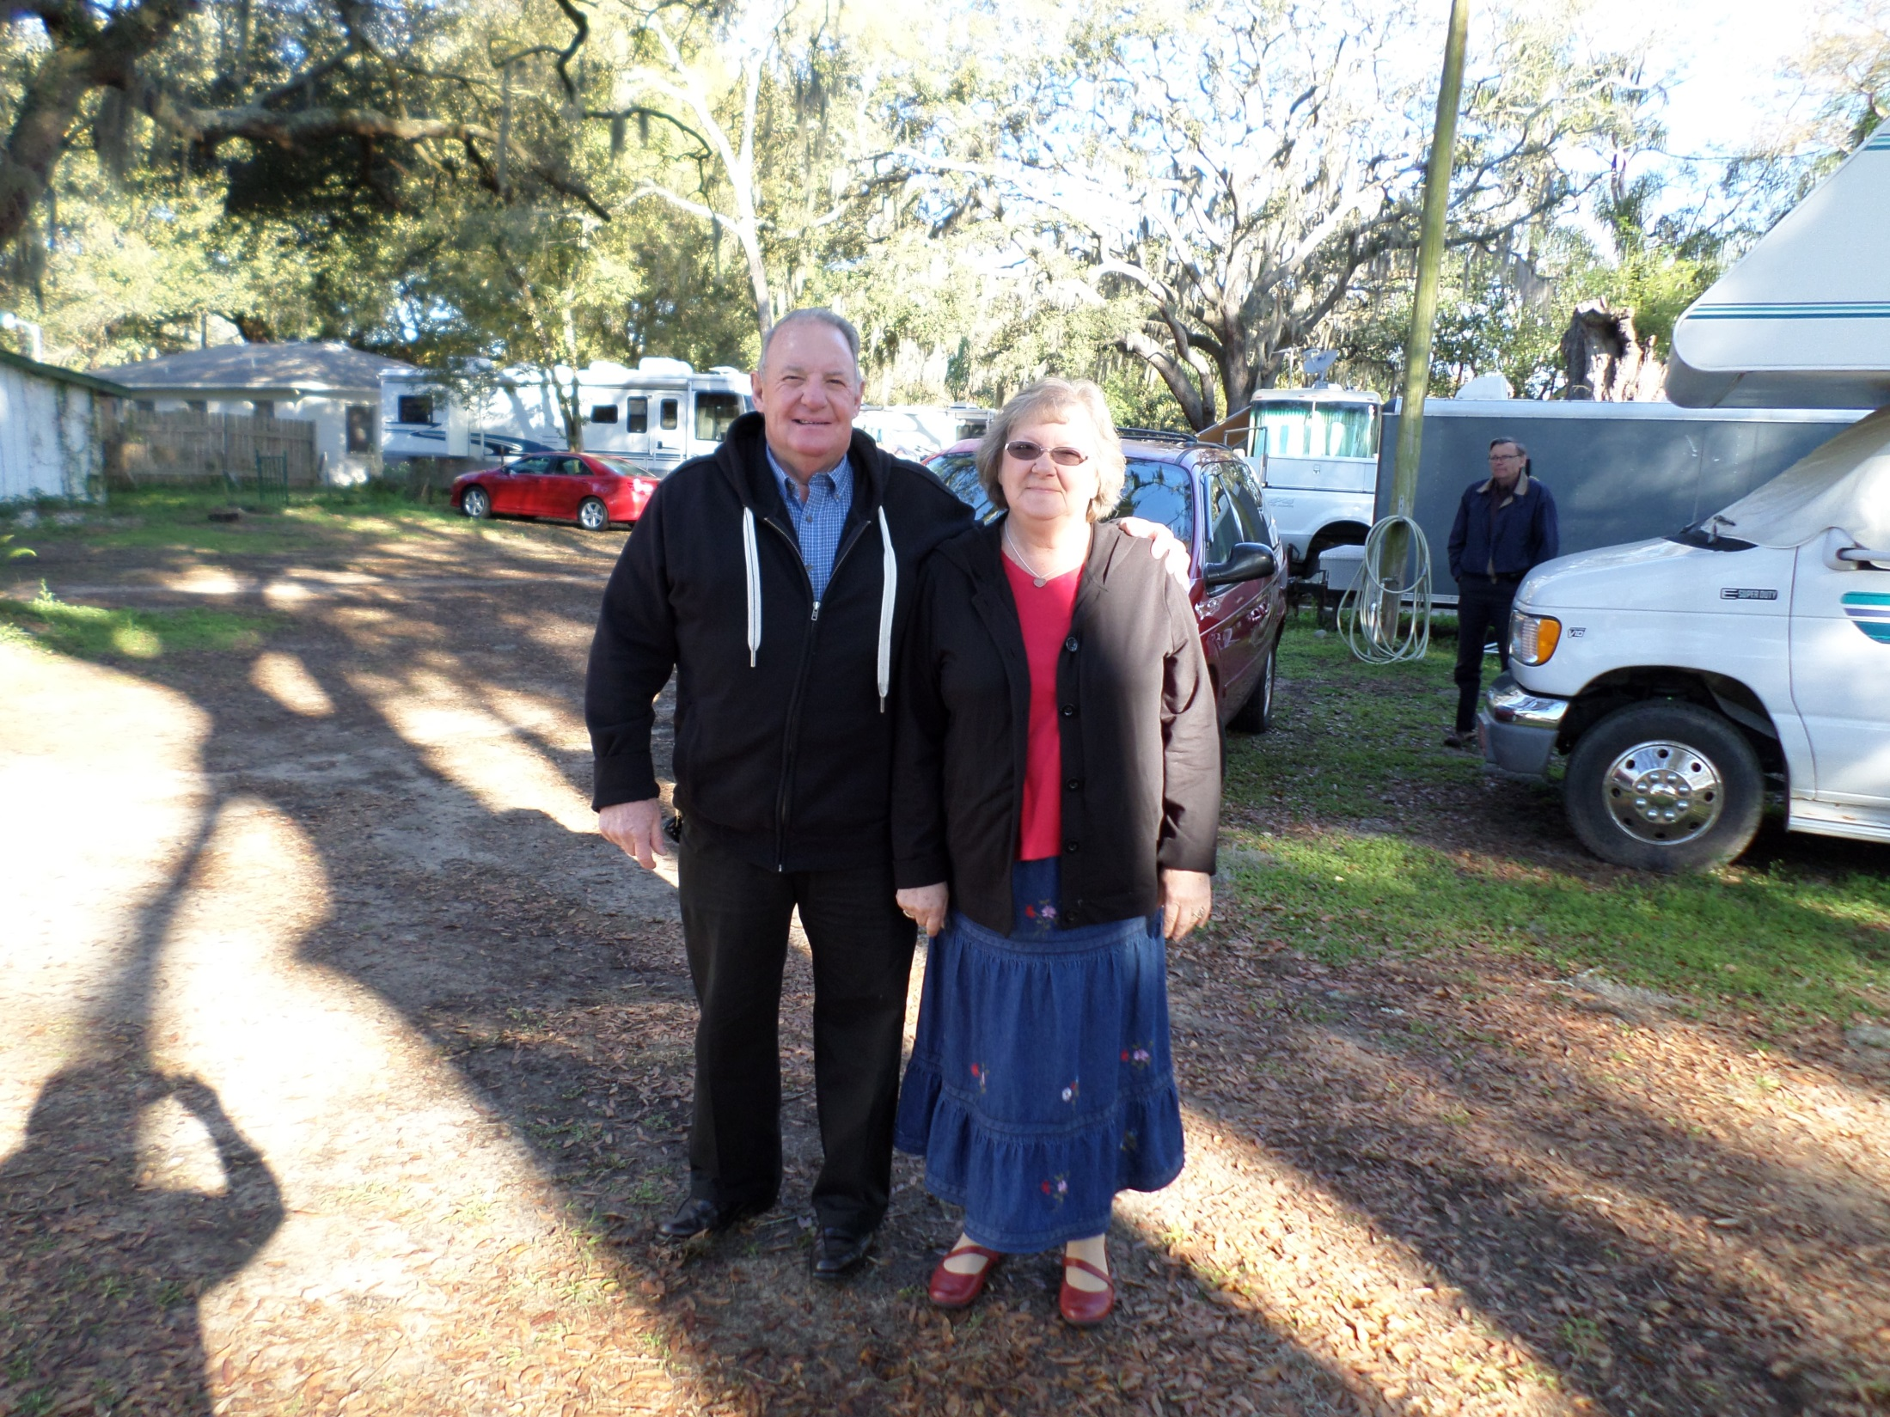
Ralph and Linda Copeland
AGM Missionaries

Slide 26
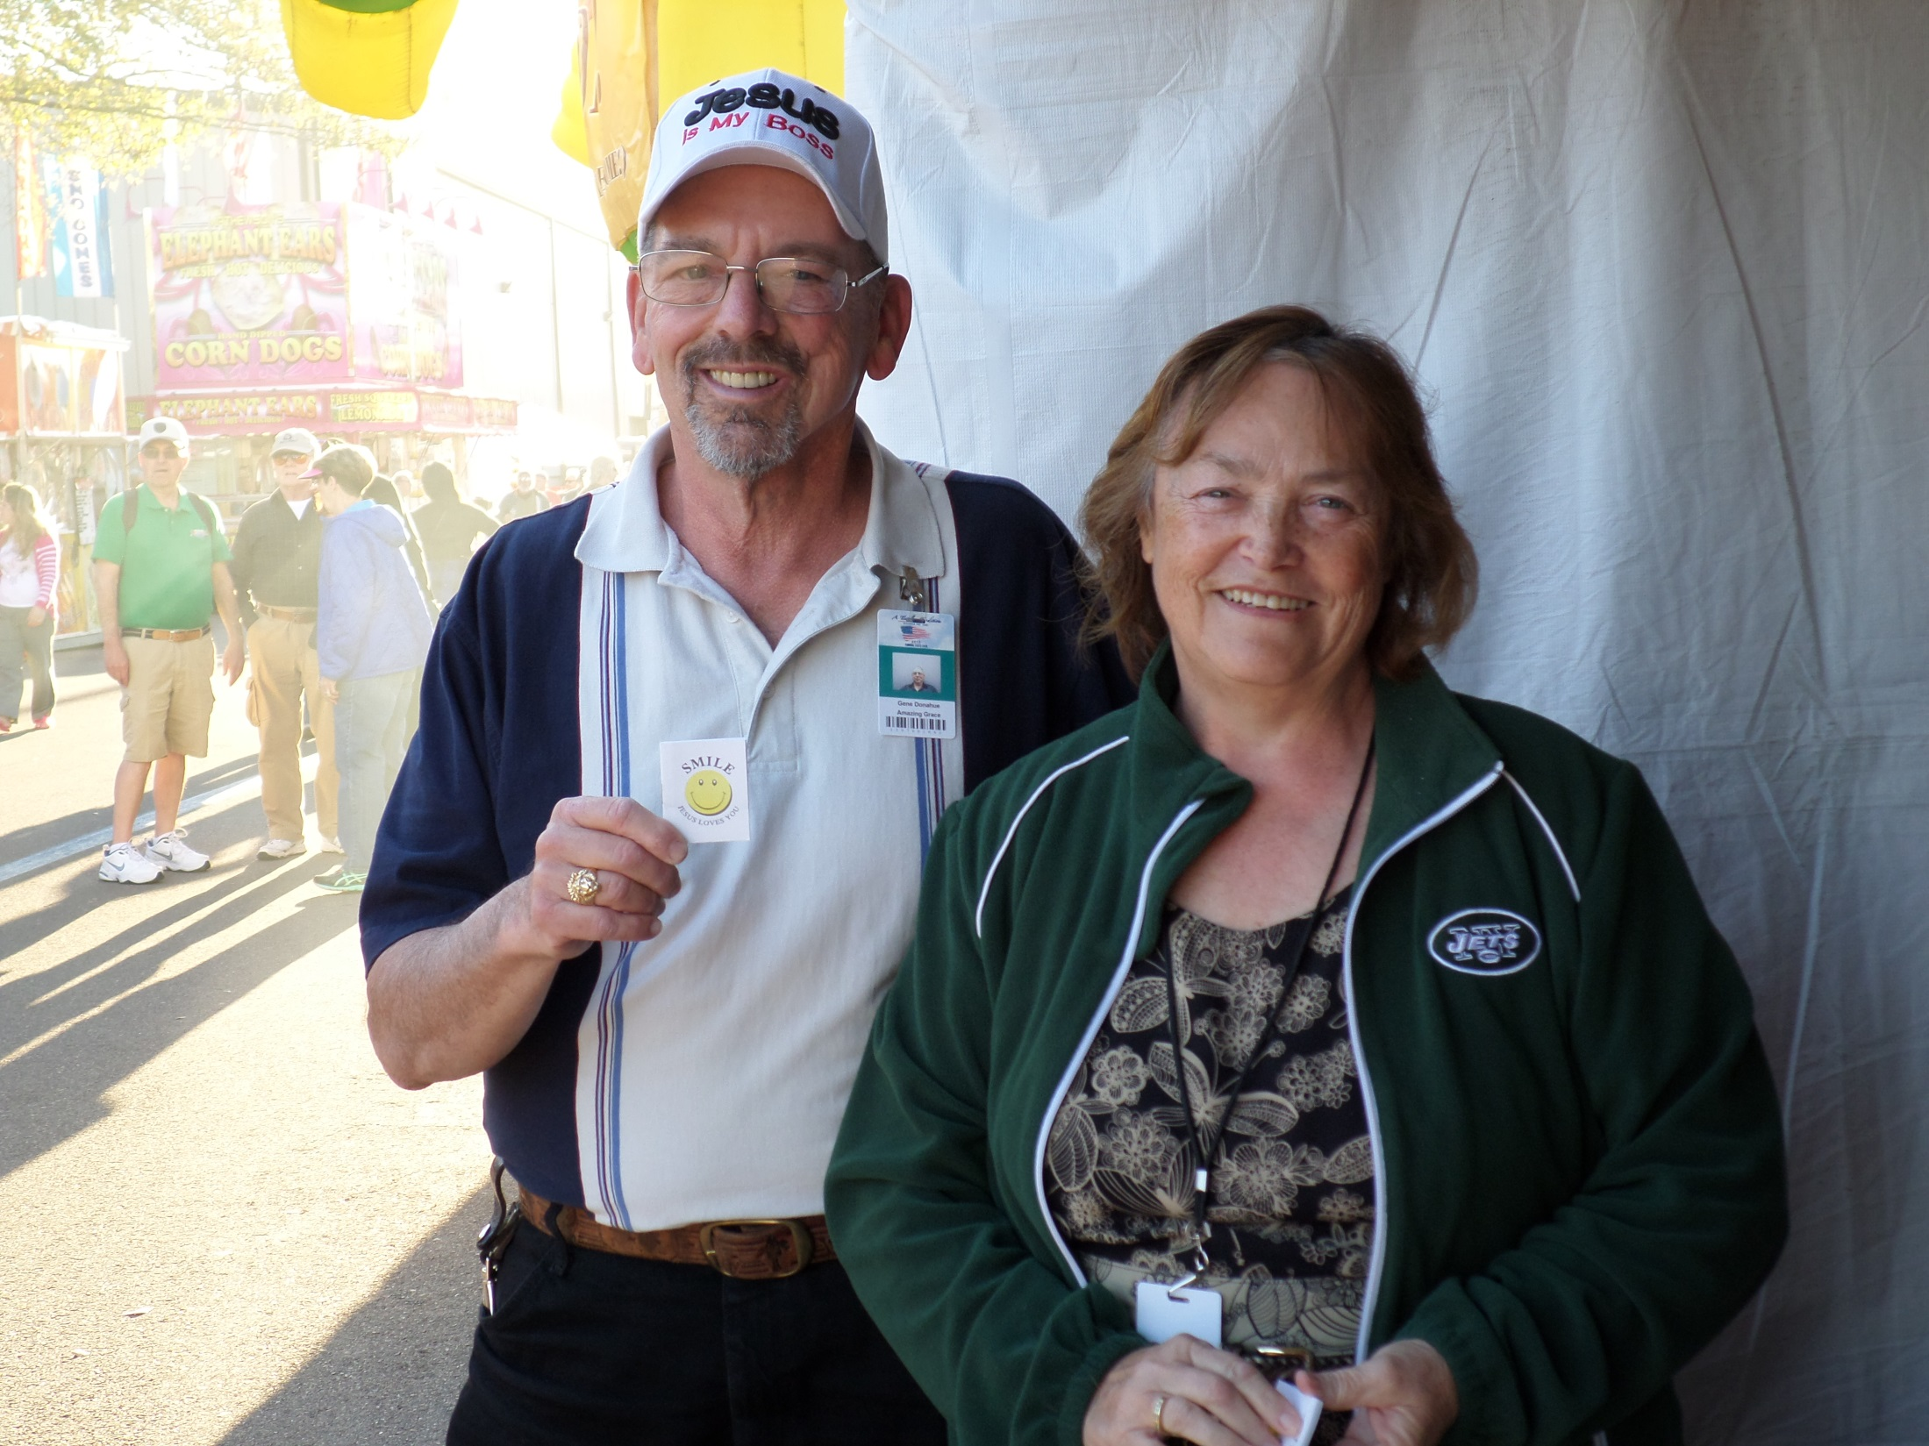
Gene and Joann Donahue
AGM Missionaries

Slide 27
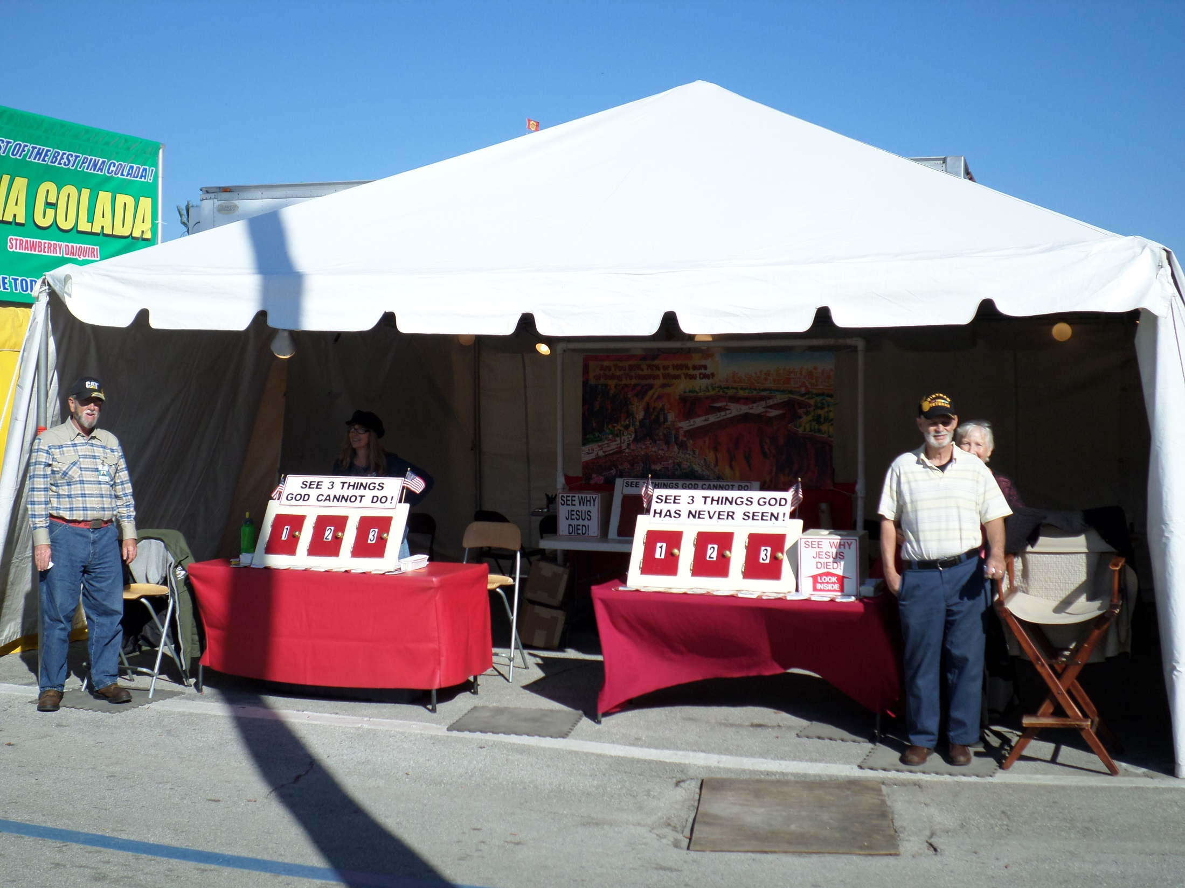

Slide 28
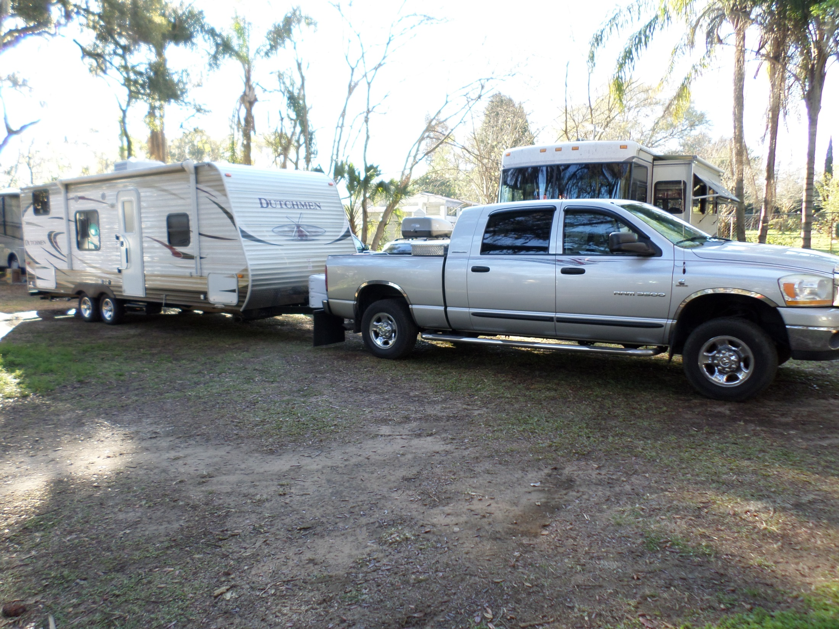
Leaving Tampa Fl. For Bryson City NC

Slide 29

Worldwide with Amazing Grace Mission 82,000 smiles were handed out.
US – 2014 – 17, 550 were saved
Year 2013 – 20,152 people were saved
Year 2012 – 21,235 people were saved
There has been a 17% drop in salvation in a three year period.
Which shows us we have work do.
Our focus should be on things eternal.

Slide 30
We Offer Churches 2 Possibilities
We offer your church an opportunity for us to come in and share and train church members on our tried and proven method of soul-winning. We have classes for teenagers, and adult or combination. We teach standard or in Power Point format, fundamental King James only. We can be reached at 828-371-5586 to schedule dates and times.
Also included, if interested, we can help you set up your own soul-winning outreach in your local community.

Slide 31
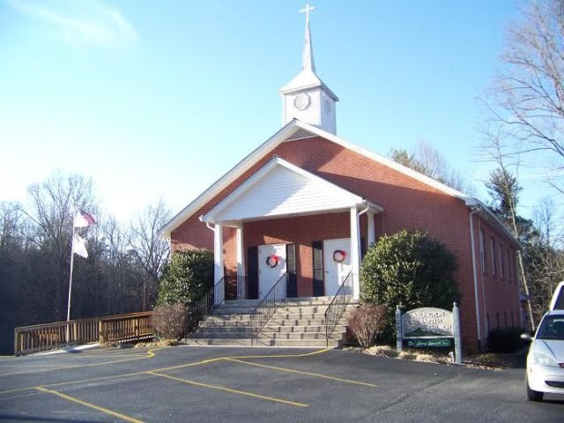
Arlington Baptist

Slide 32
Buddy and Ann Walls
Amazing Grace Mission 184 Walls Lane Bryson City, NC 28713
Home: Cell: 828-371-5586/342-6894
Website: tweagle3.wix.com/saved
E-mail: tweagle3@gmail.com
Sending Church: Arlington Baptist
670 Hughes Br. Rd. Bryson City NC 28713
Church website: www.arlingtonbaptistchurchbc.com
Prayer Cards available

