Slide 1
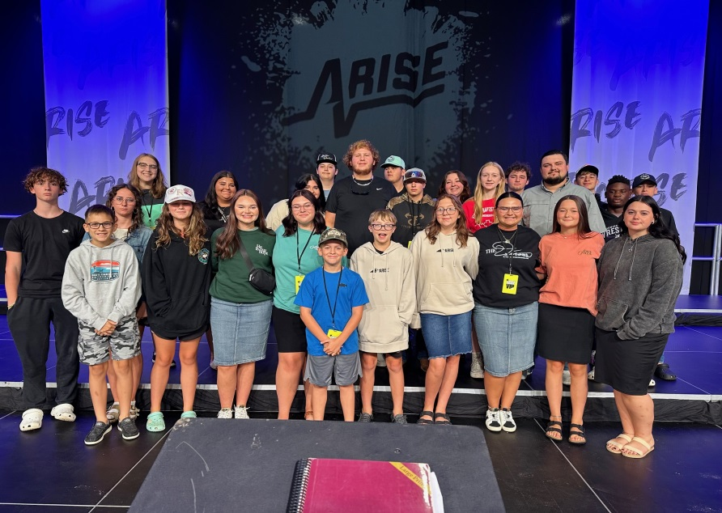
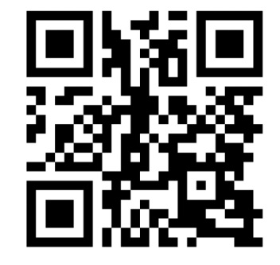
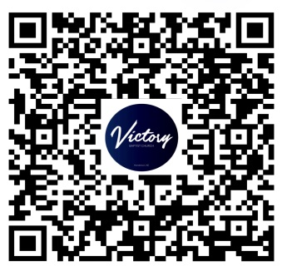

This is your opportunity to INVEST in the lives of our YOUTH
Our website:
Sending a check:
Victory Baptist Church
PO Box 592
Henderson, NC 27536
Victorybaptistnc.com
Living in Victory Youth Group Arise 2024
Scan the QR code to Give to help our youth trip to ARISE 2025
Memo ARISE 2025

Slide 2
Arise is a youth conference that hosts many teens from all over the country in Pigeon Forge, TN each July. CT Townsend Ministries founded and sponsors the conference. In 2024 there were over 5,000 teens and young adults in attendance. We were blessed to take 48 people including chaperones.
Living in Victory is our youth group at the Victory Baptist Church in Henderson, NC. It is headed up by Caleb Parnell, Brooke Parnell, and Spring Roberson. Living in Victory meets every Wednesday night at 7:30 in their own building at the Victory Baptist Church.
Our youth have been to Arise in 2021, 2022, 2023 & 2024. We have had young people saved every year that we have gone. We are planning to go back for the 2025 Conference.
We are thankful for the people in our church that give and sacrifice to help our youth group attend this conference. If you would like to help sponsor our trip please see the other side for details on how to give.
Thank you for praying about the opportunity to invest in the lives of our youth.

